Slide 1
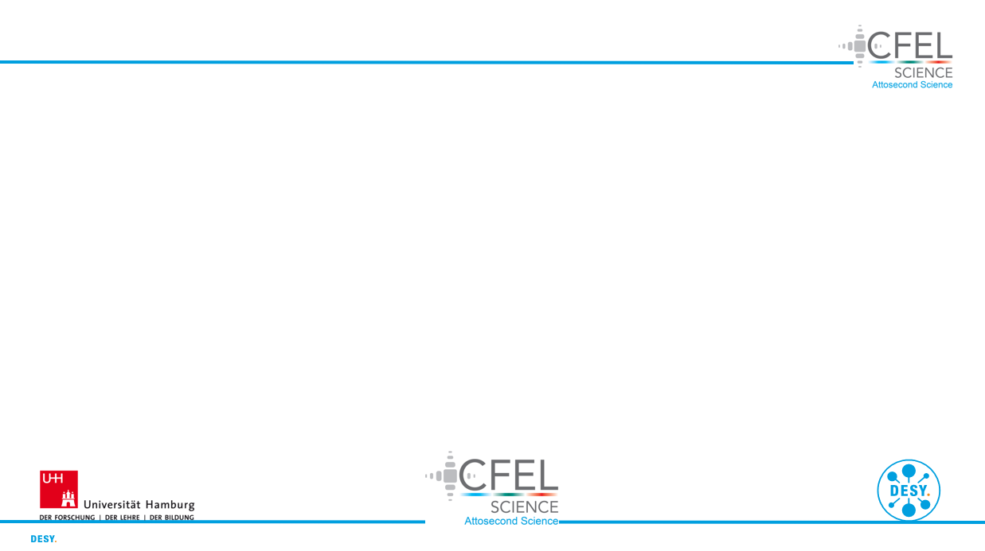
Modelling of nonlinear light up-conversion from intense femtosecond laser pulses
DESY Summer Student Programme 2023
Project Presentation
Group: CFEL-ATTO
Supervisor: Josina Hahne
David Amorim (University of Glasgow)

Slide 2
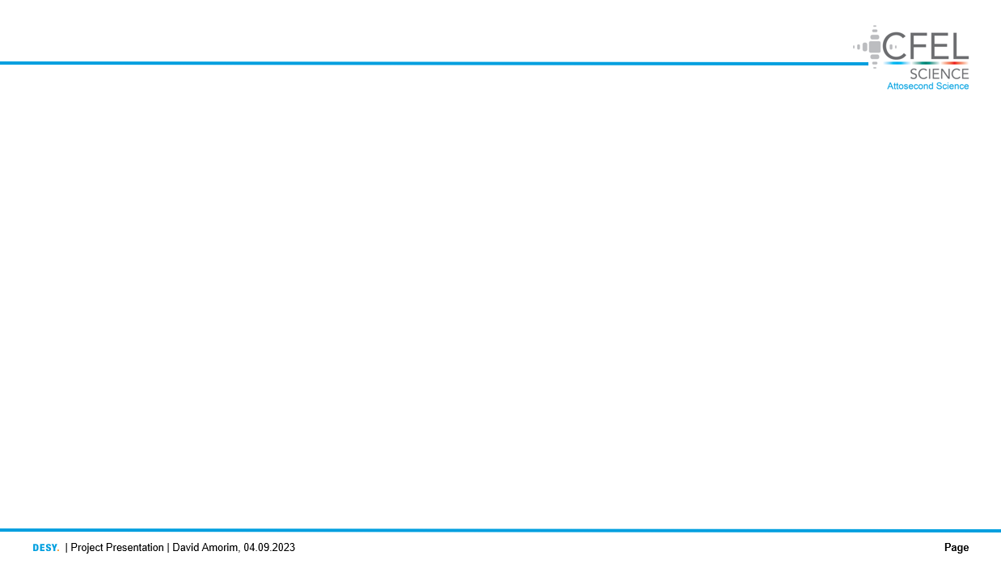
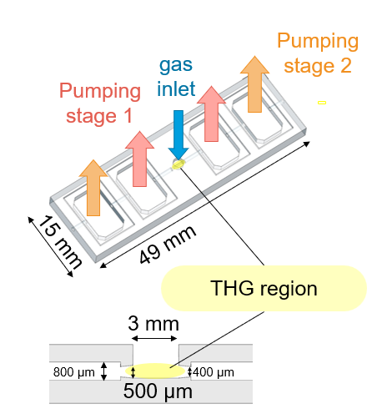
1. Motivation
The CFEL-ATTO group uses THG of few-femtosecond IR laser pulses in a gas cell to generate ultrashort UV pulses
The aim of this project was to produce simulations of the THG process to:
Reproduce the experimental conditions in the gas
Study the effects and parameters shaping UV generation
Compare the new gas chip to the old (2019) gas cell
The resulting simulations can, at this stage, be viewed as a first approximation
Fig. 1: the fused silica chip used for gas confinement. Reproduced from Josina Hahne’s master’s thesis defence

Slide 3
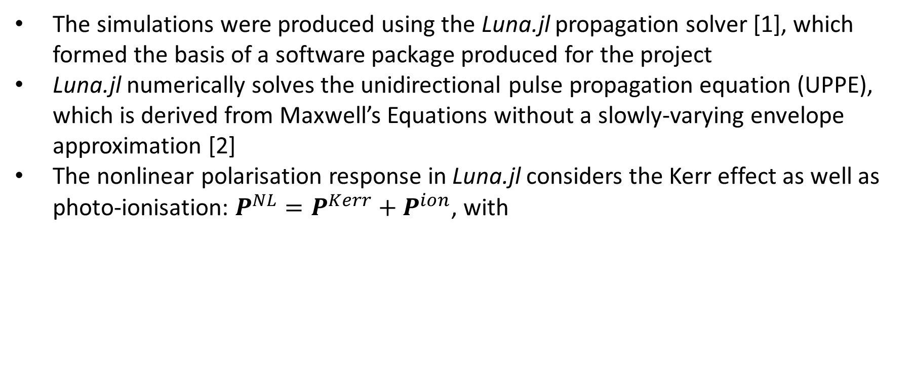
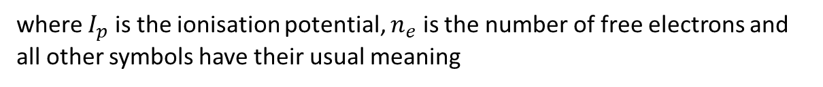
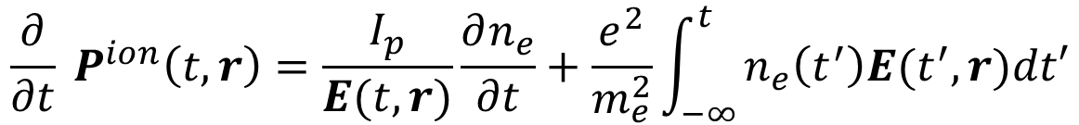
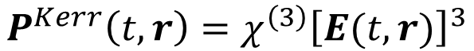
2. Background
The simulations were produced using the Luna.jl propagation solver [1], which formed the basis of a software package produced for the project
Luna.jl numerically solves the unidirectional pulse propagation equation (UPPE), which is derived from Maxwell’s Equations without a slowly-varying envelope approximation [2]
The nonlinear polarisation response in Luna.jl considers the Kerr effect as well as photo-ionisation: $P^{NL}=P^{Kerr}+P^{ion}$, with
$$P^{Kerr}\left(t, r\right)=χ^{\left(3\right)}{\left[E(t,r)\right]}^{3}$$
(1)
$${\frac{∂}{∂t} P}^{ion}\left(t,r\right)=\frac{I_{p}}{E(t,r)}\frac{∂n_{e}}{∂t}+\frac{e^{2}}{m_{e}^{2}}\int_{−∞ }^{t}{n_{e}\left(t^{′}\right)E(t^{′},r)dt′}$$
(2)
where $I_{p}$ is the ionisation potential, $n_{e}$ is the number of free electrons and all other symbols have their usual meaning

Slide 4
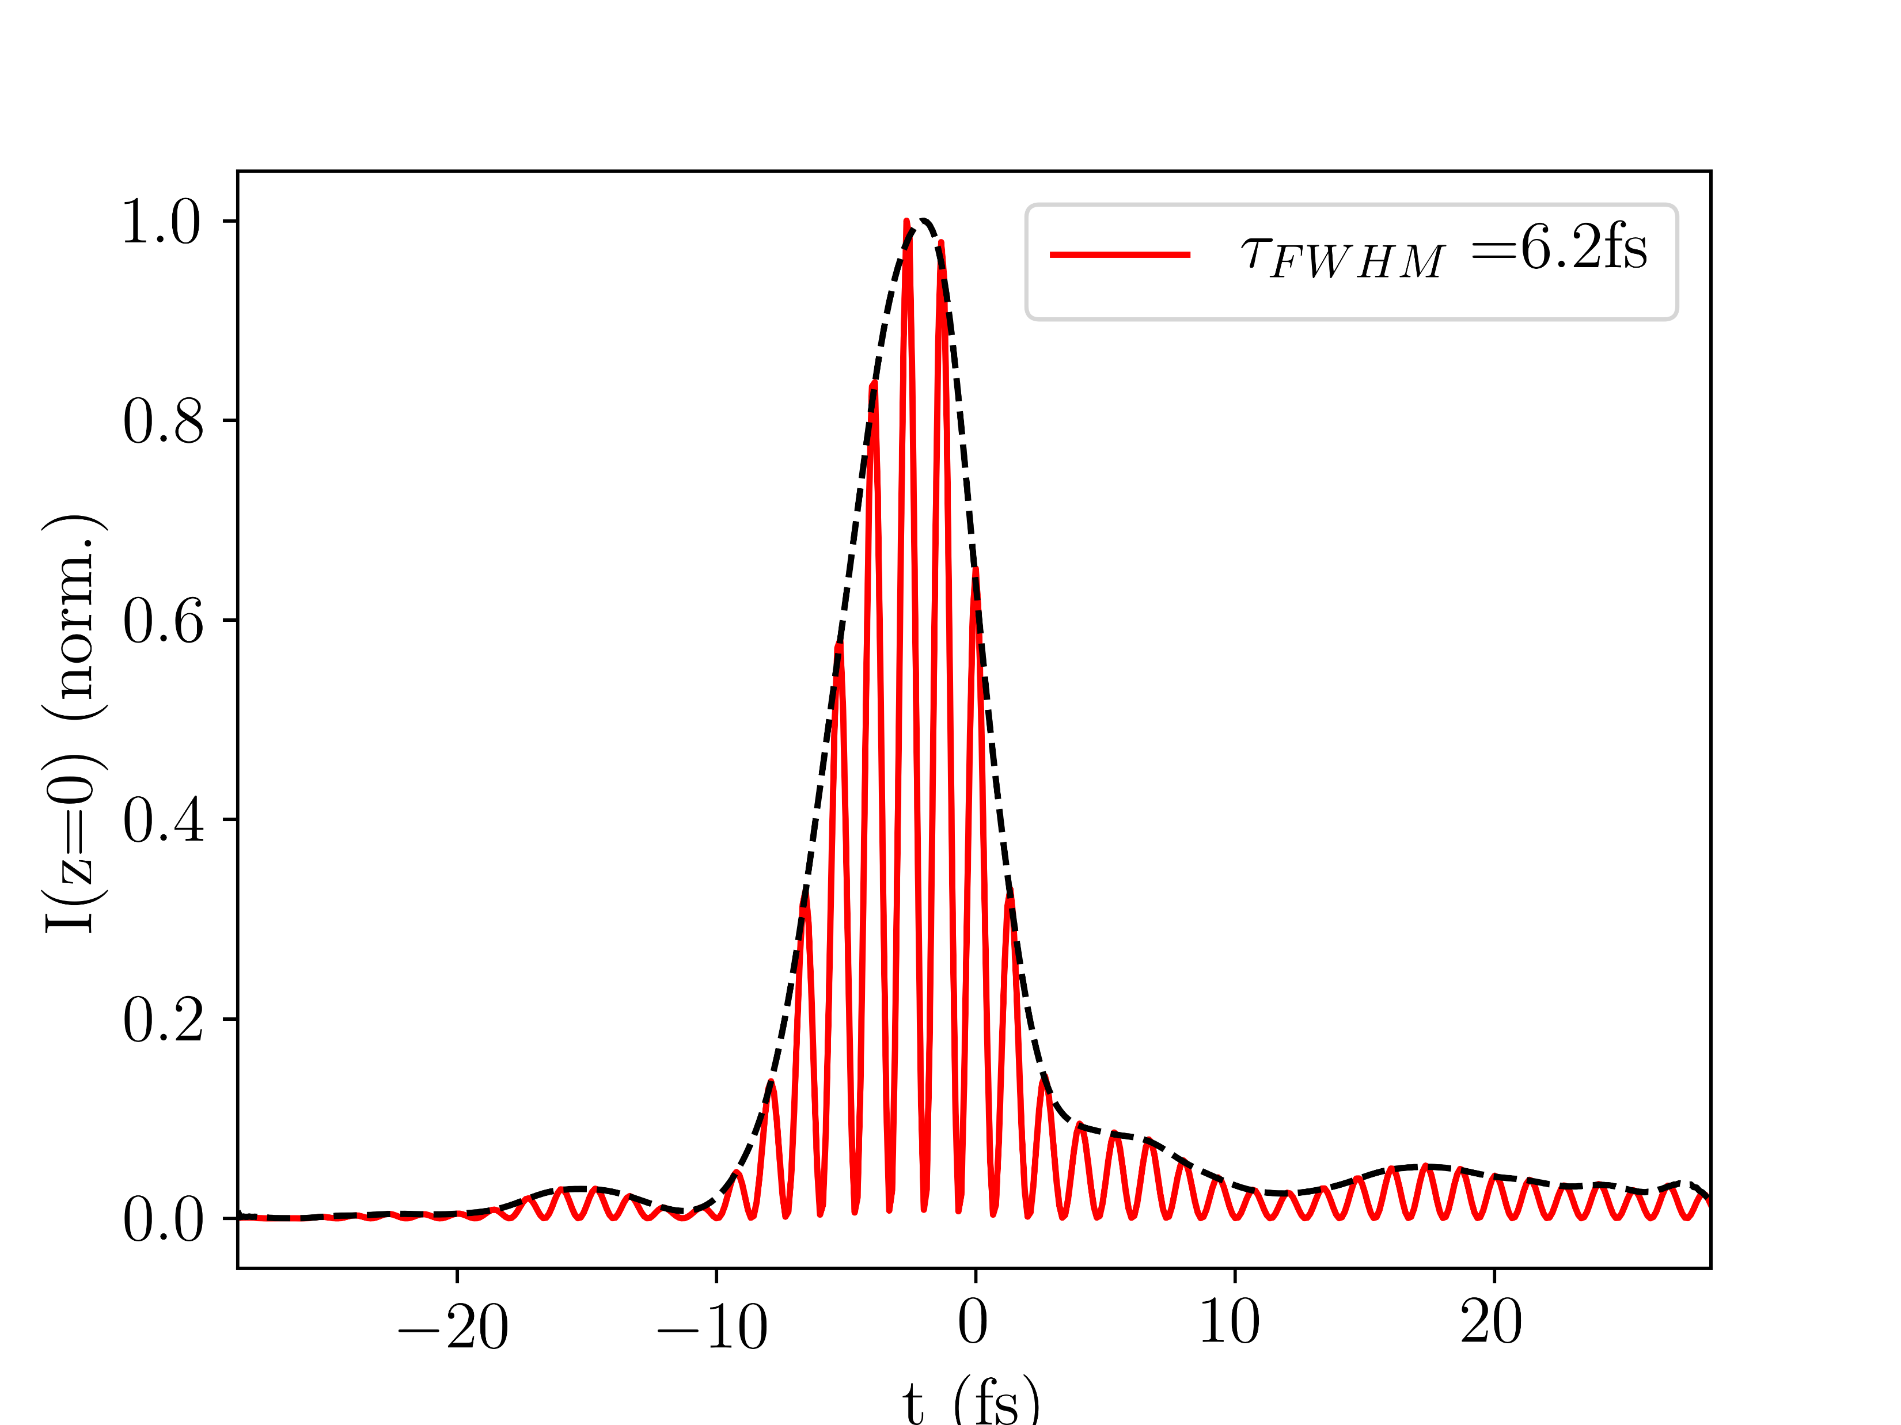
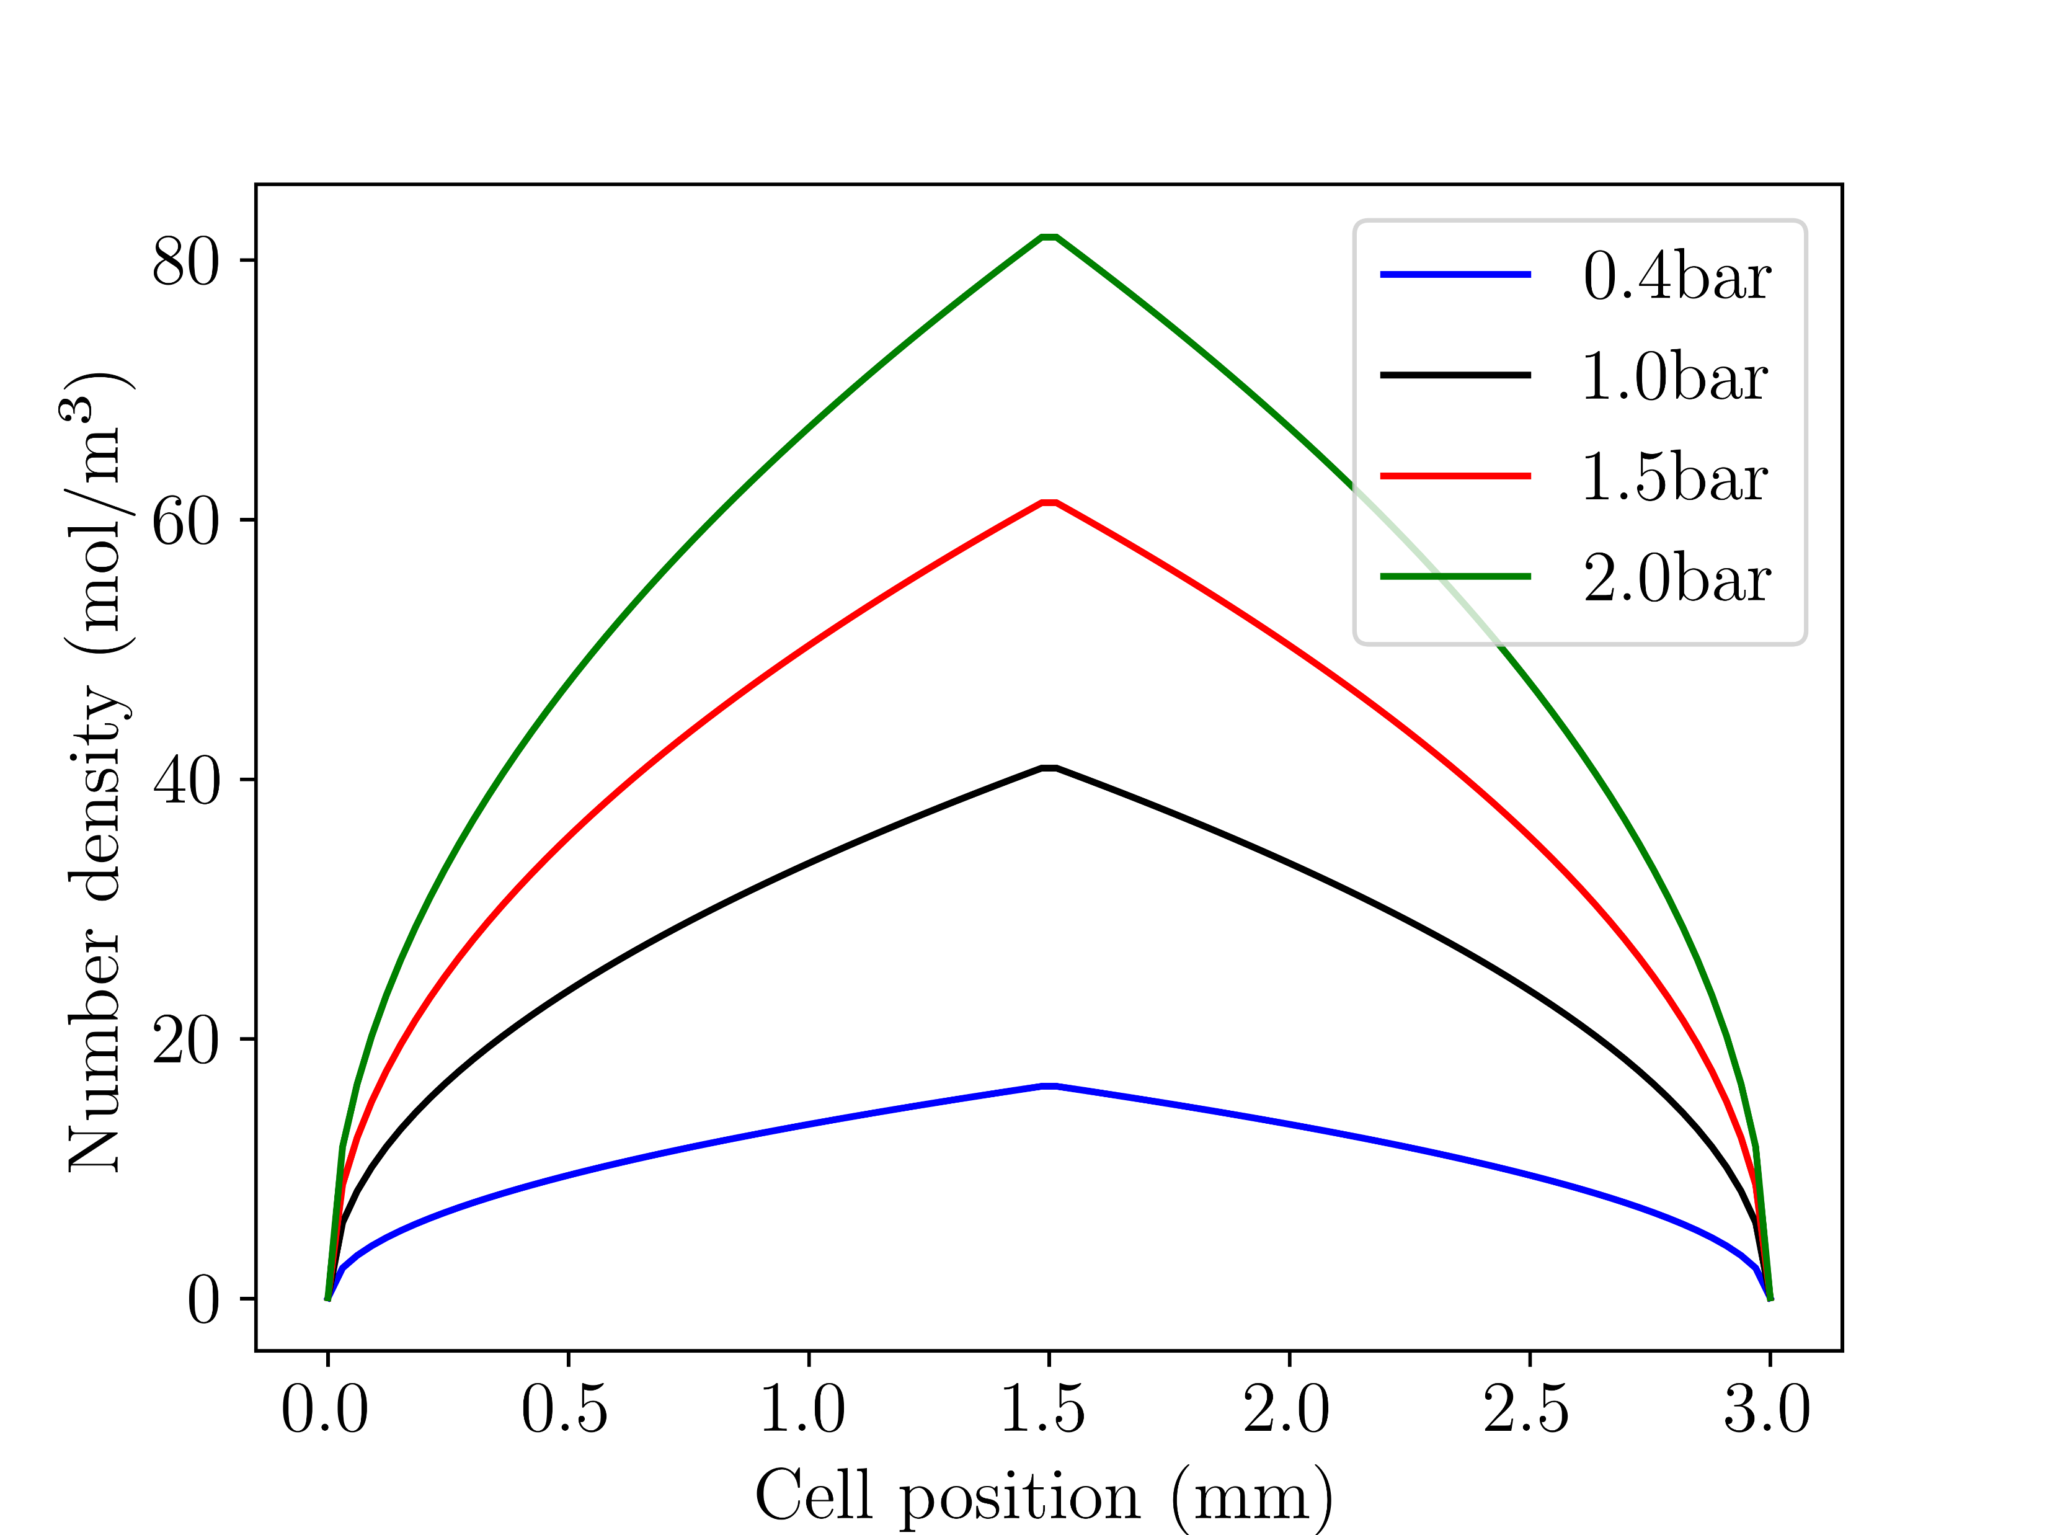
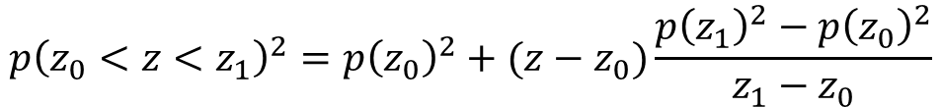
3. Simulation inputs
The simulation input was based on measured data, as far as possible:
Time-intensity data of the IR input beam is read in
The spatial profile of the input beam is assumed to be a Gaussian
The gas density profile in the central interaction region is approximated using a gradient model:
While a variety of gases, pressures, and input powers can be simulated, this presentation focusses on Argon and Neon
Fig. 2: NIR input pulse in the time domain
$$p{\left(z_{0}<z<z_{1}\right)}^{2}=p{\left(z_{0}\right)}^{2}+(z−z_{0})\frac{p{\left(z_{1}\right)}^{2}−p{\left(z_{0}\right)}^{2}}{z_{1}−z_{0}}$$
(3)
Fig. 3: gradient model of the gas distribution

Slide 5
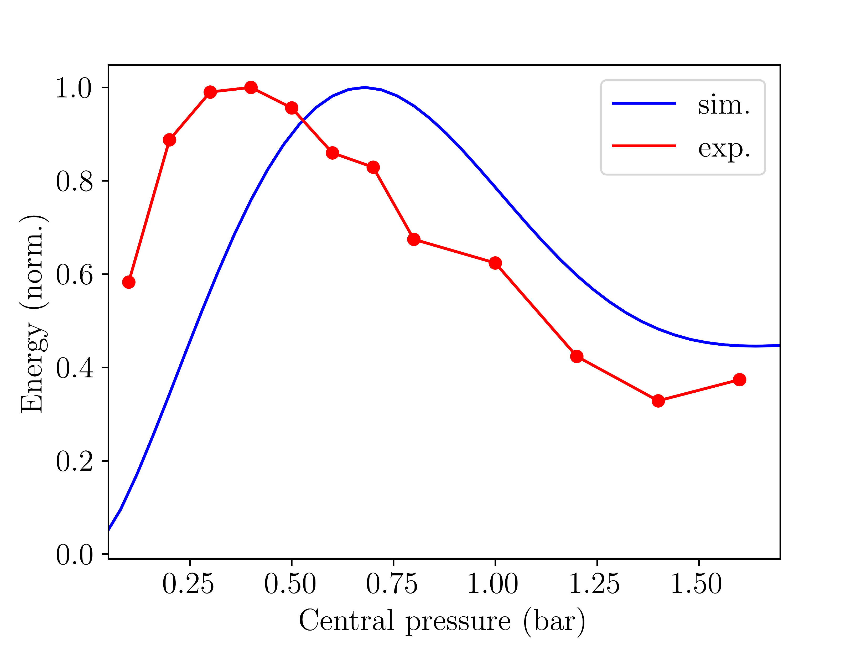
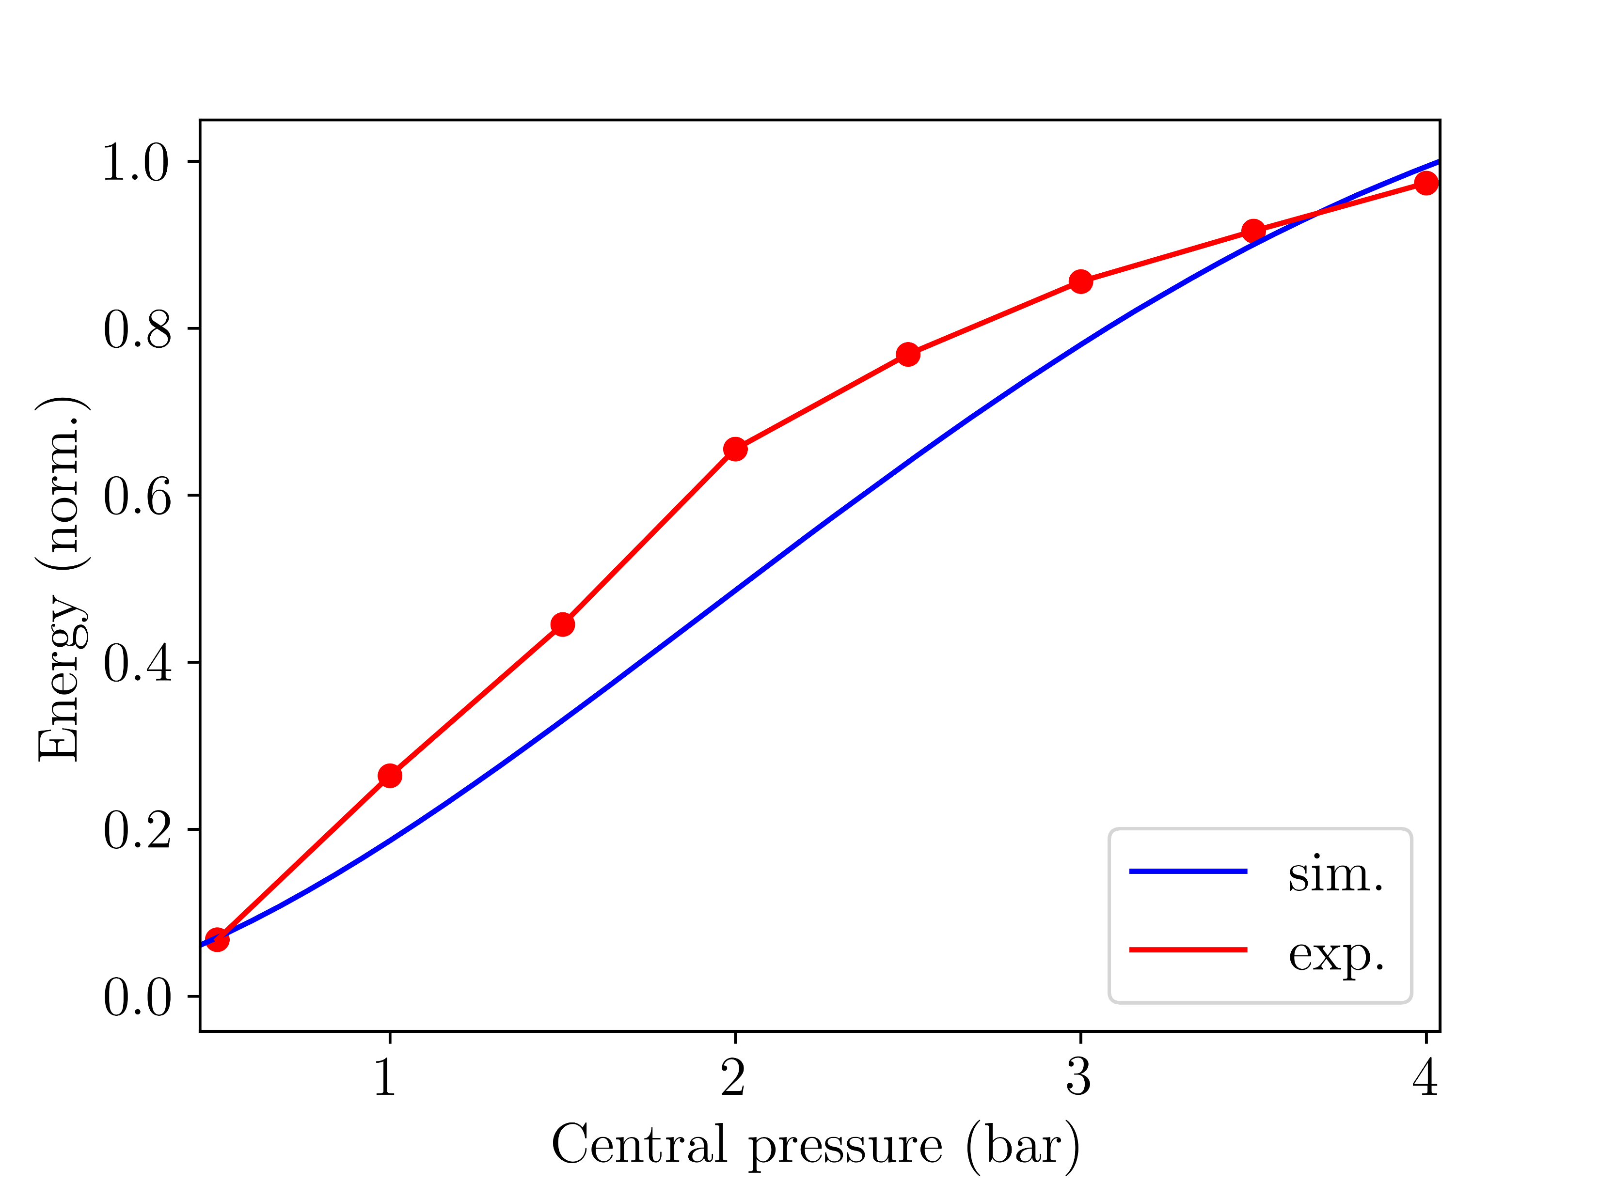
4.I Comparison with experiment
The simulated UV energies qualitatively reproduce experimental trends, although energy values are overestimated by a factor of 10 and pressures must be rescaled (factor 2.5):
Fig. 4: Normalised UV output energies for Argon with 150mW
input beam power. Simulation pressures are rescaled.
Fig. 5: Normalised UV output energies for Neon with 400mW
input beam power. Simulation pressures are rescaled.

Slide 6
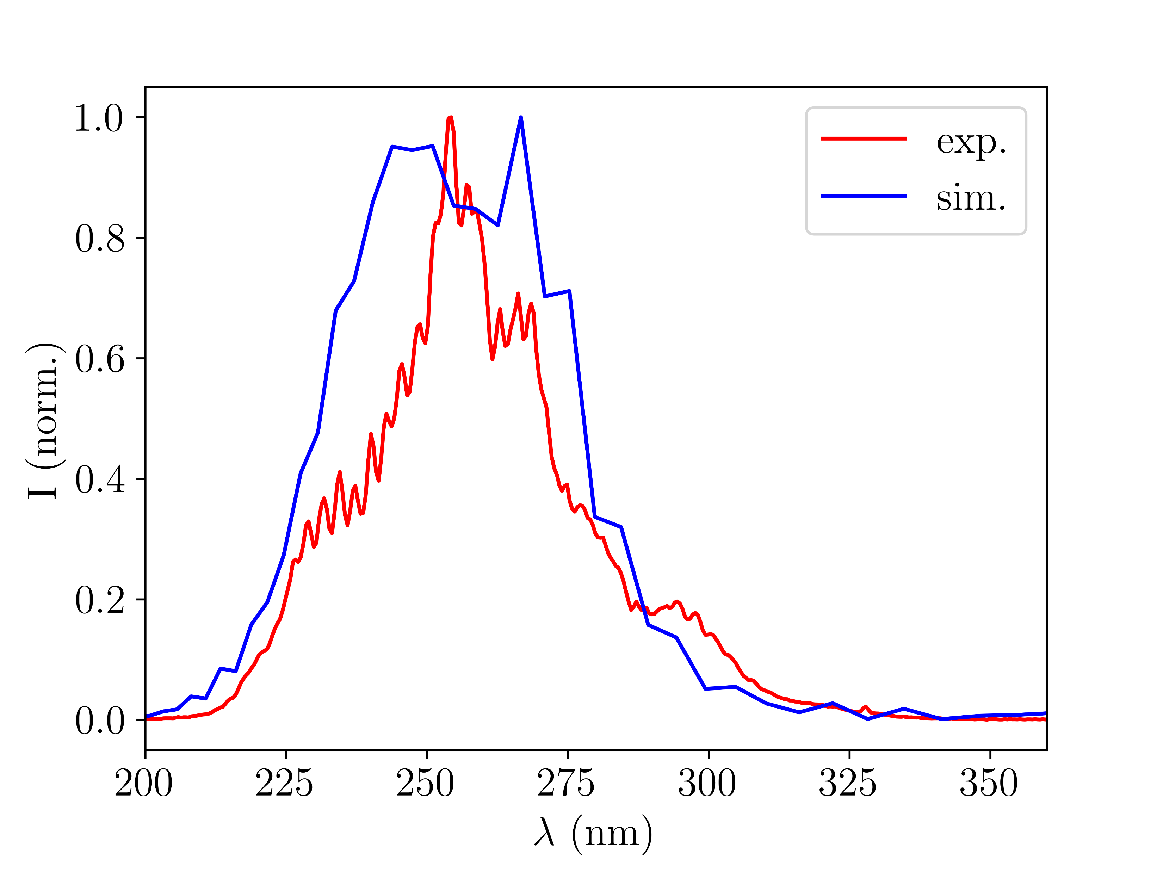
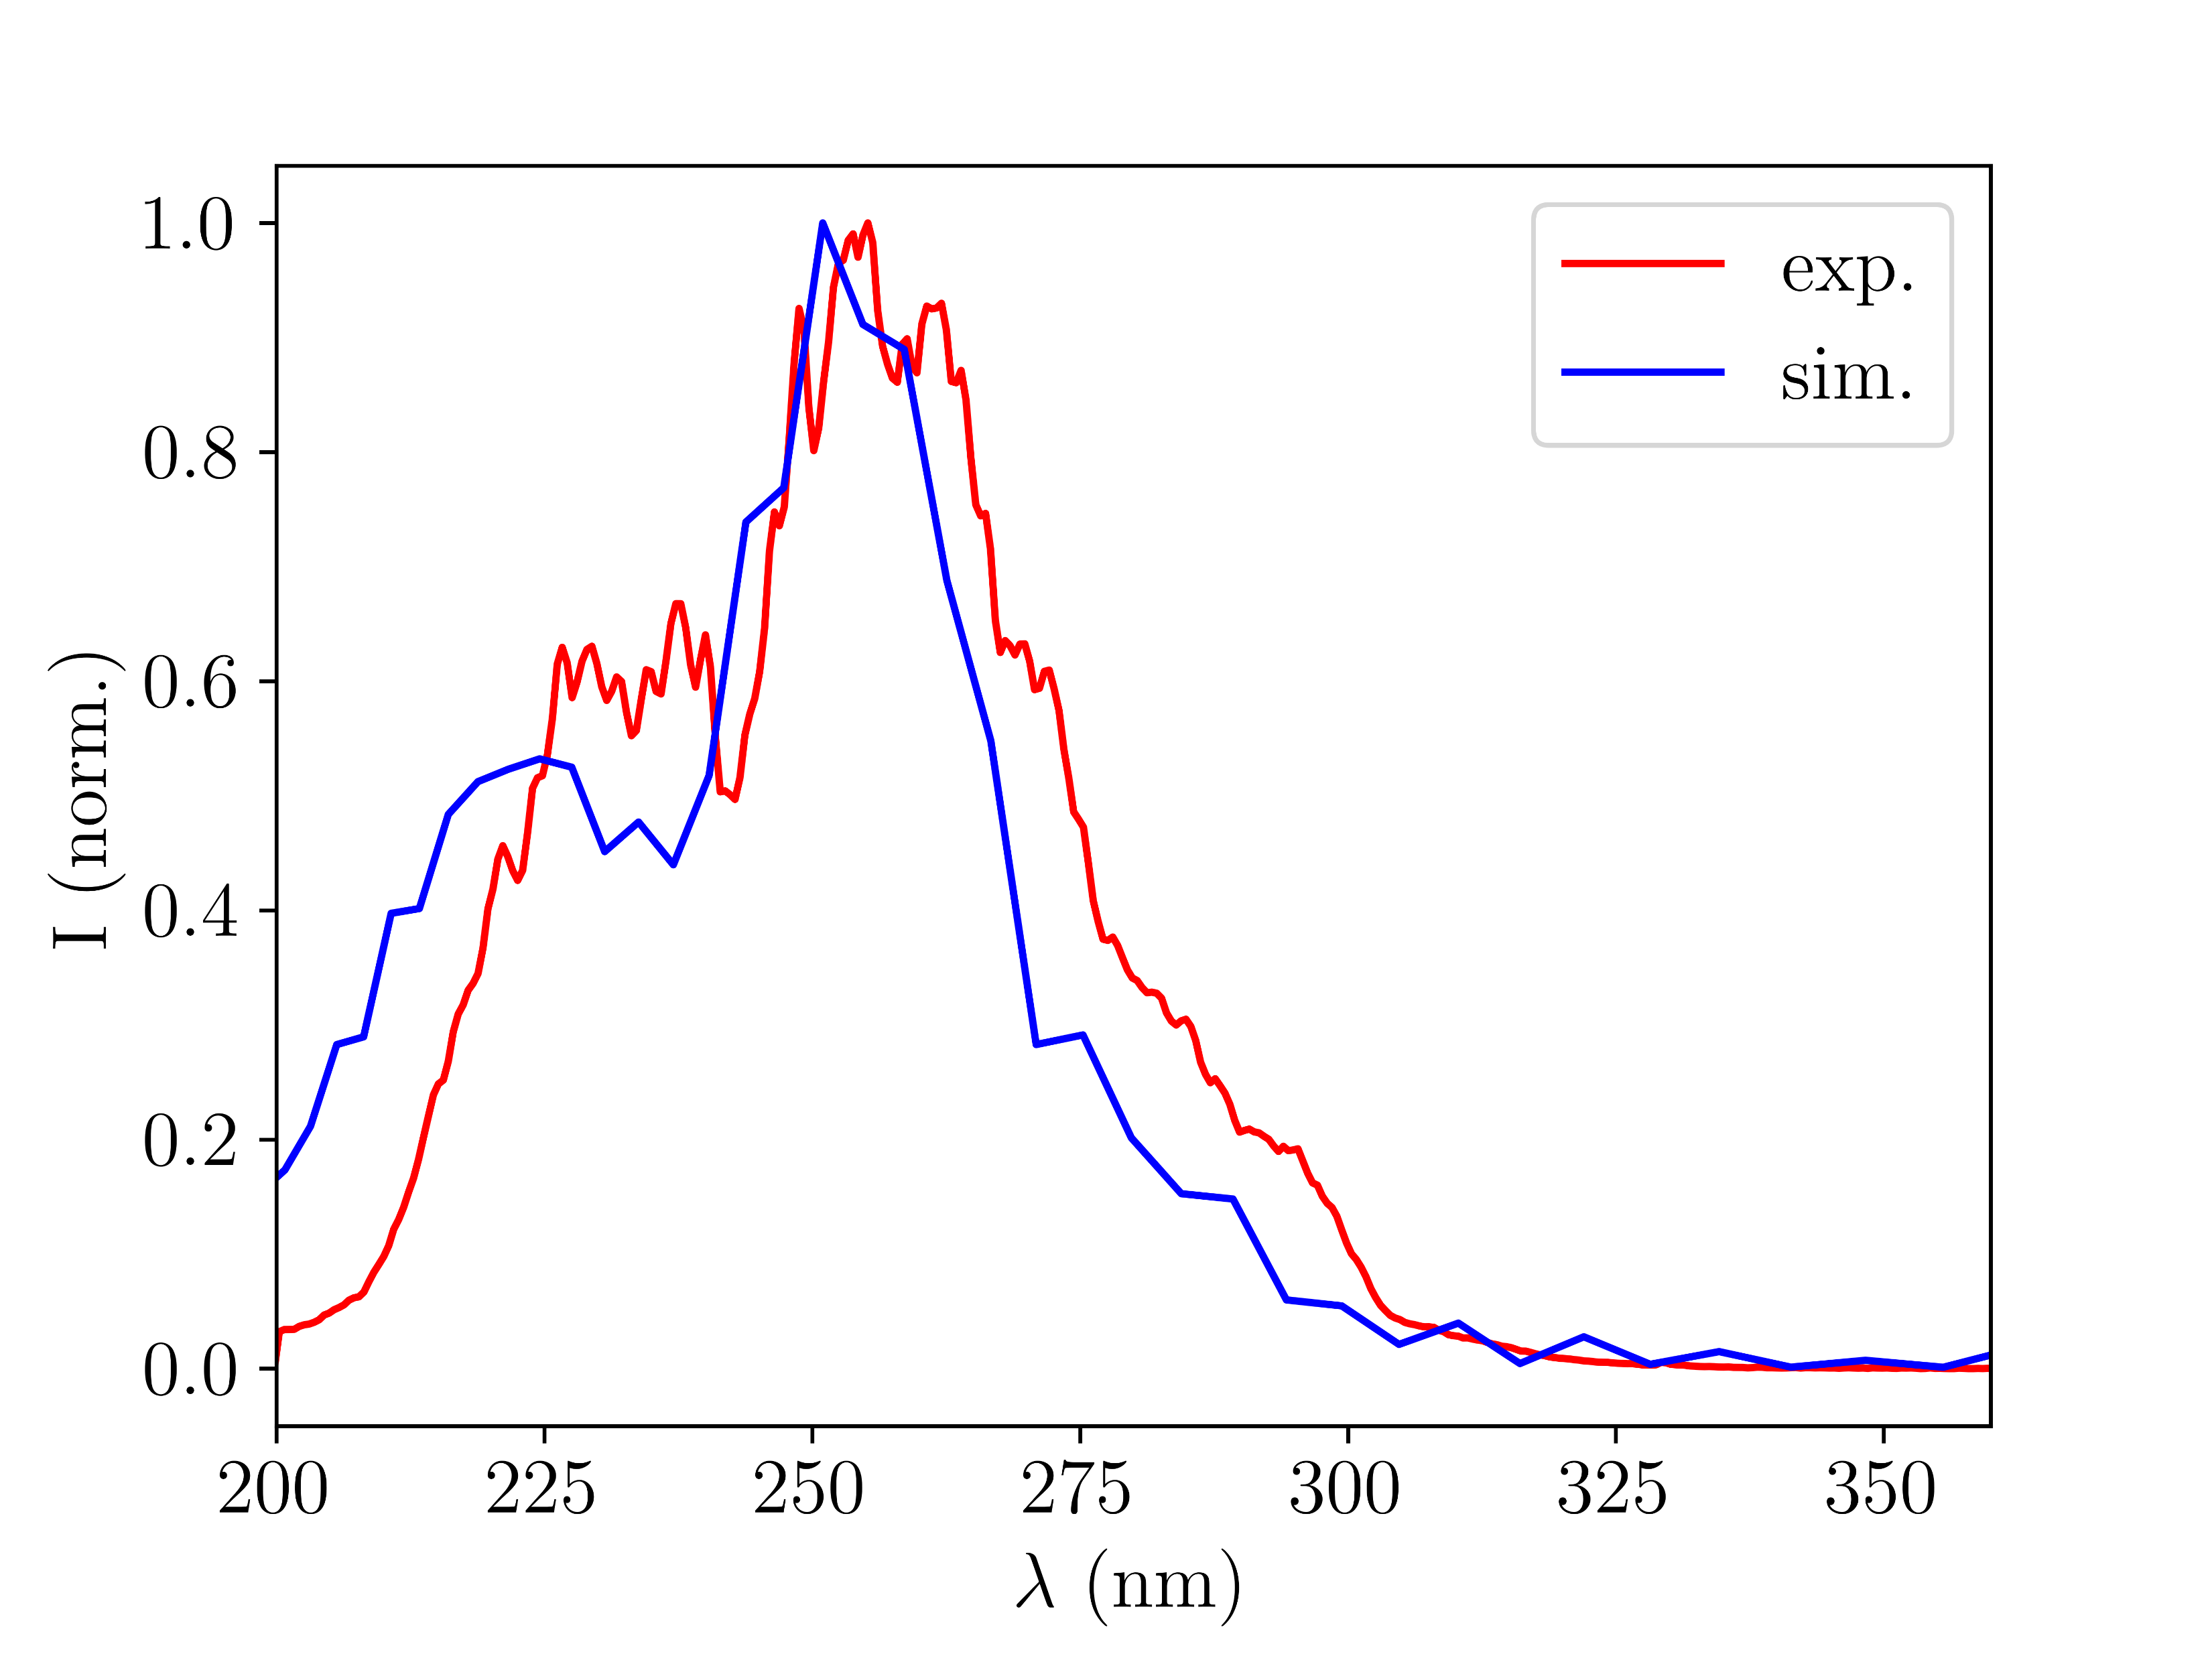
4.I Comparison with experiment
Using rescaled pressures, the simulated UV spectra agree reasonably well with experiment:
Fig. 6: UV output spectra for Argon with 150mW
input beam power and 0.4bar central pressure
Fig. 7: UV output spectra for Neon with 400mW input beam power and 2.0bar central pressure

Slide 7
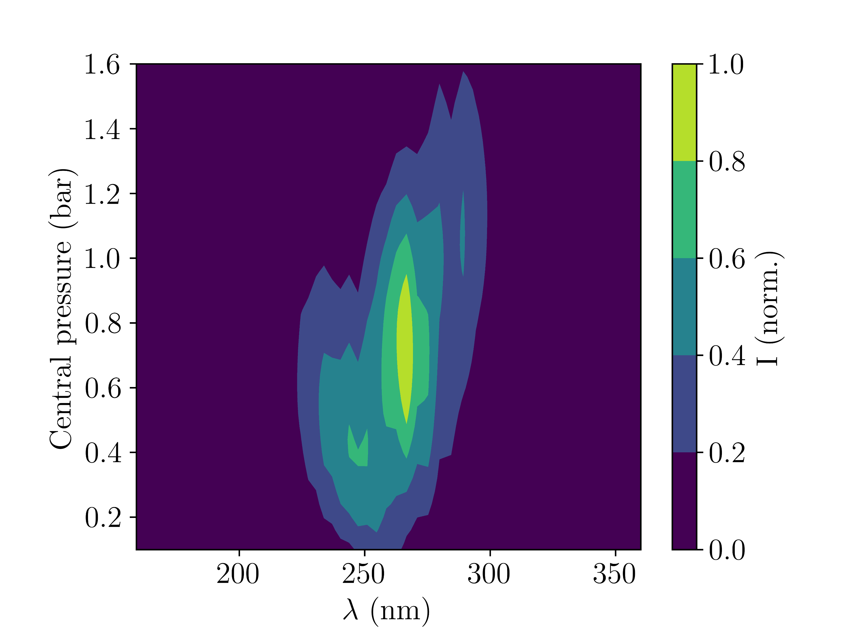
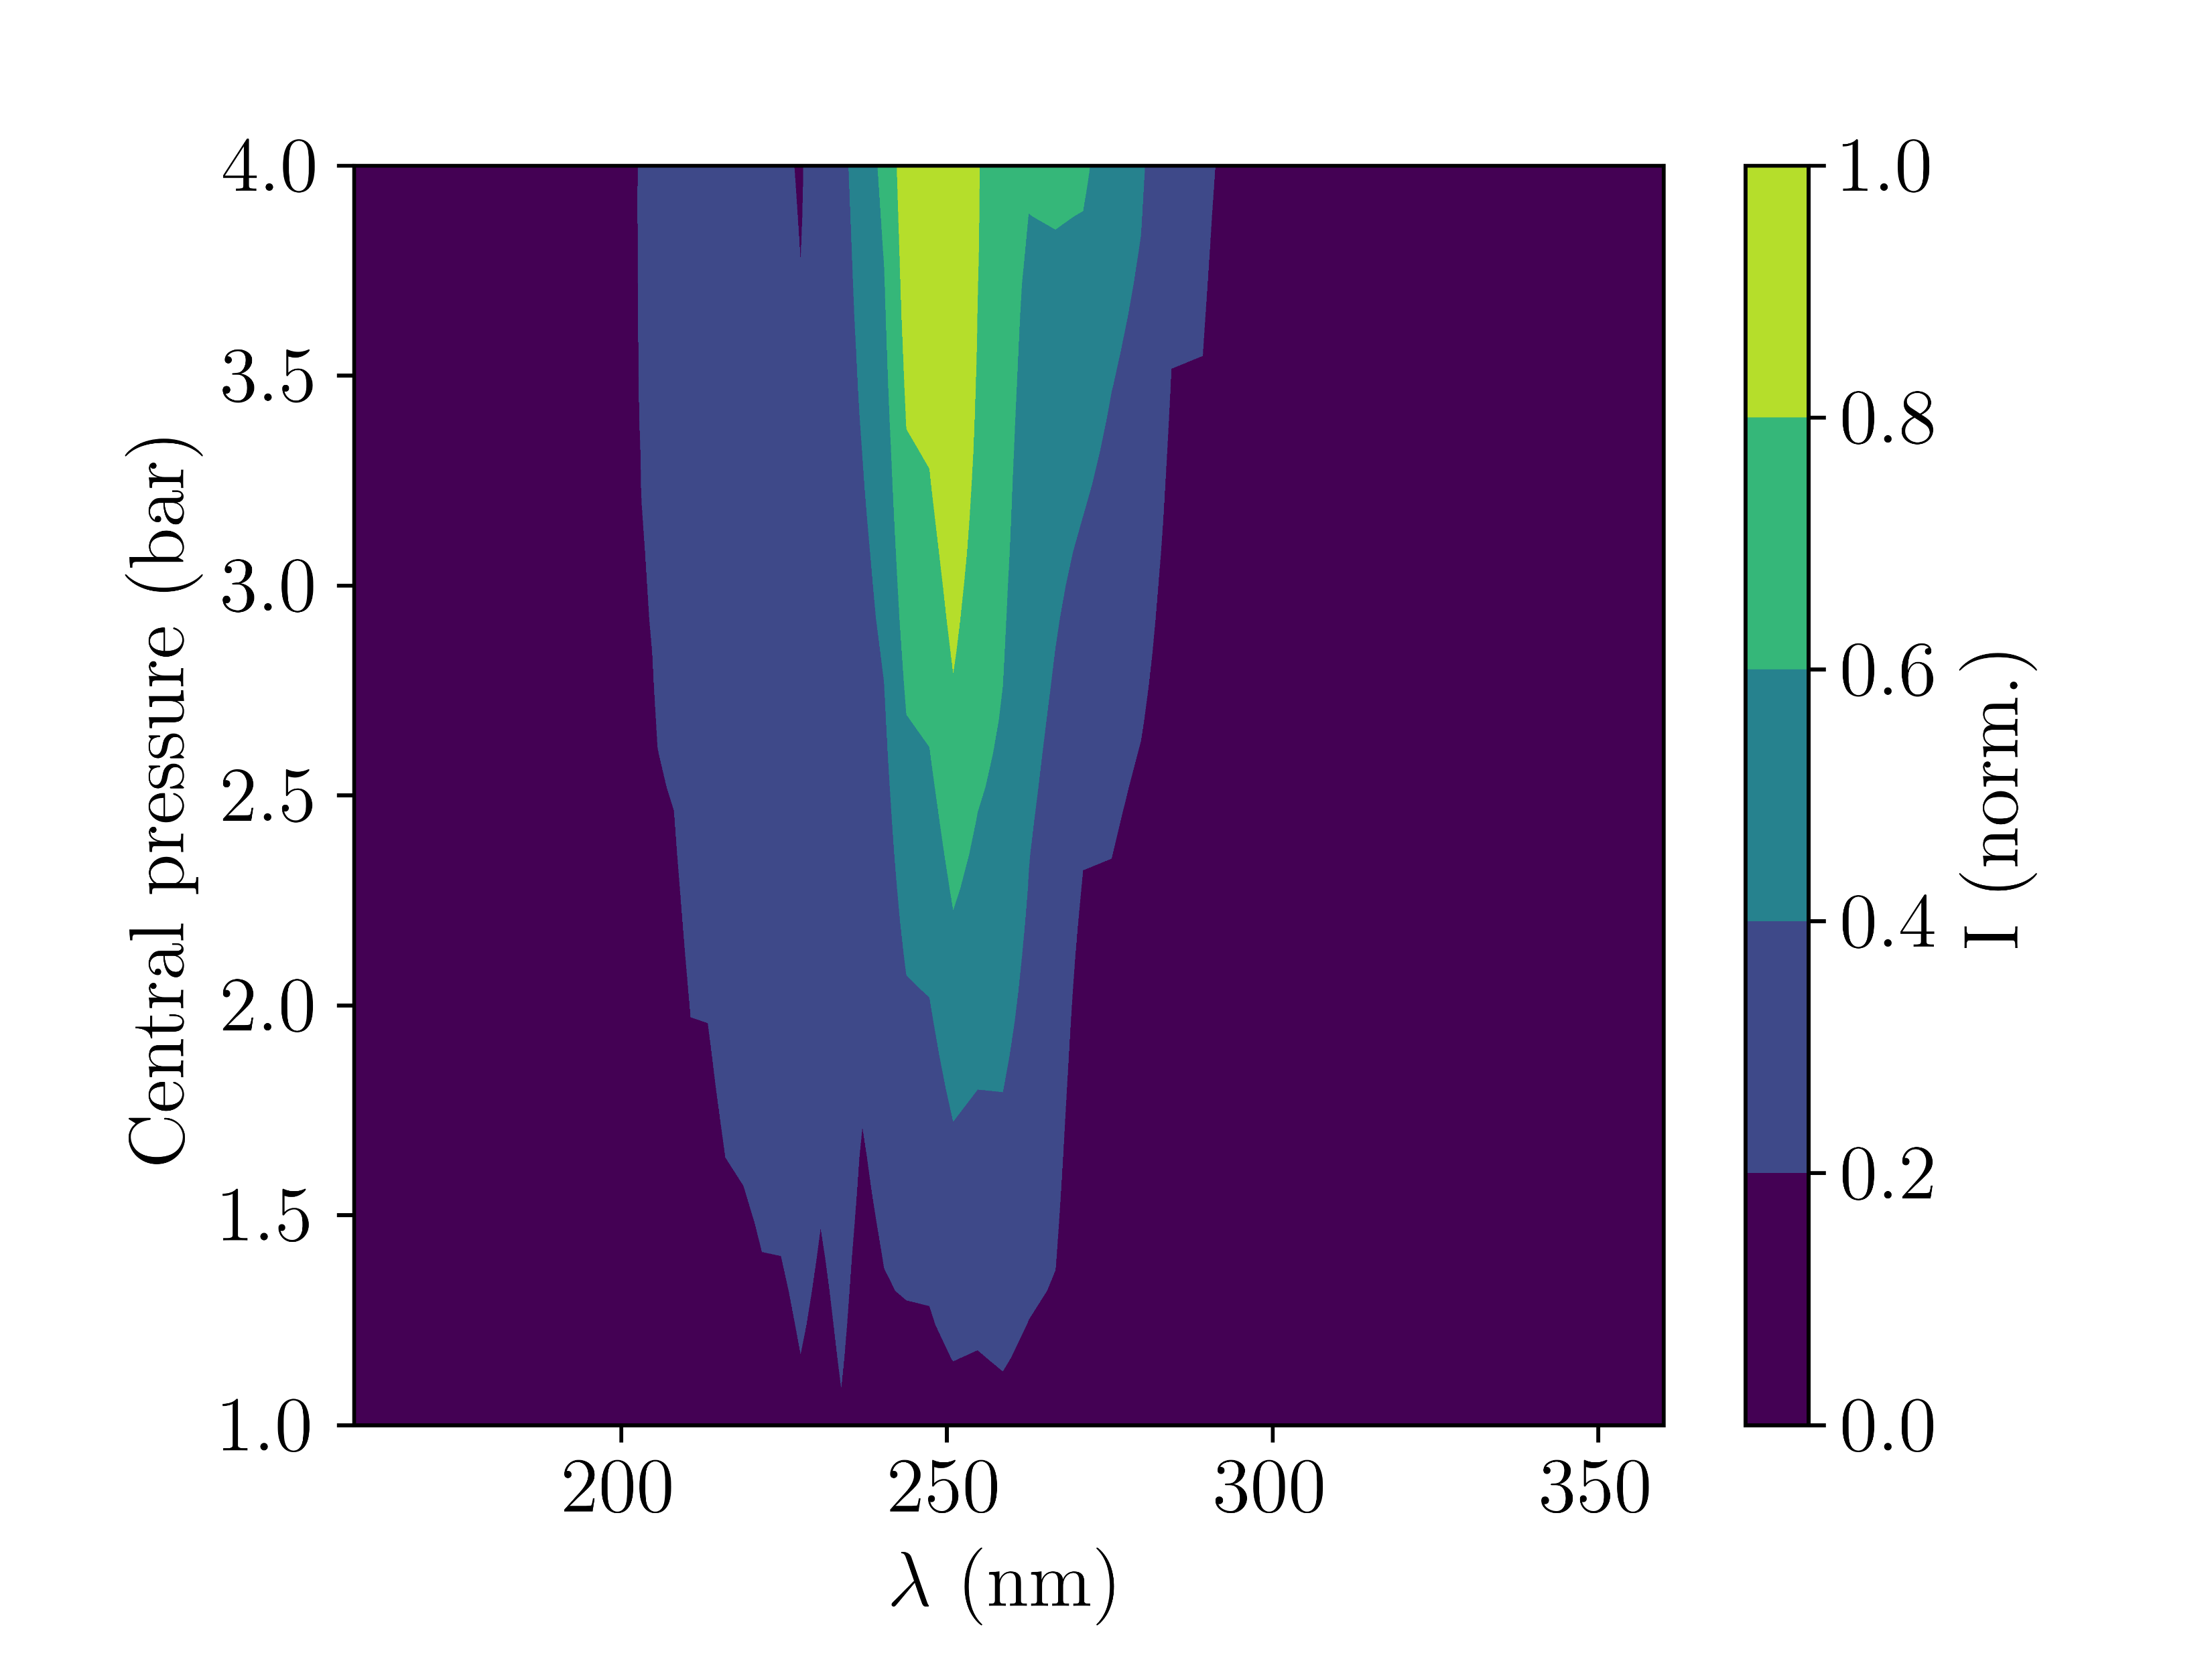
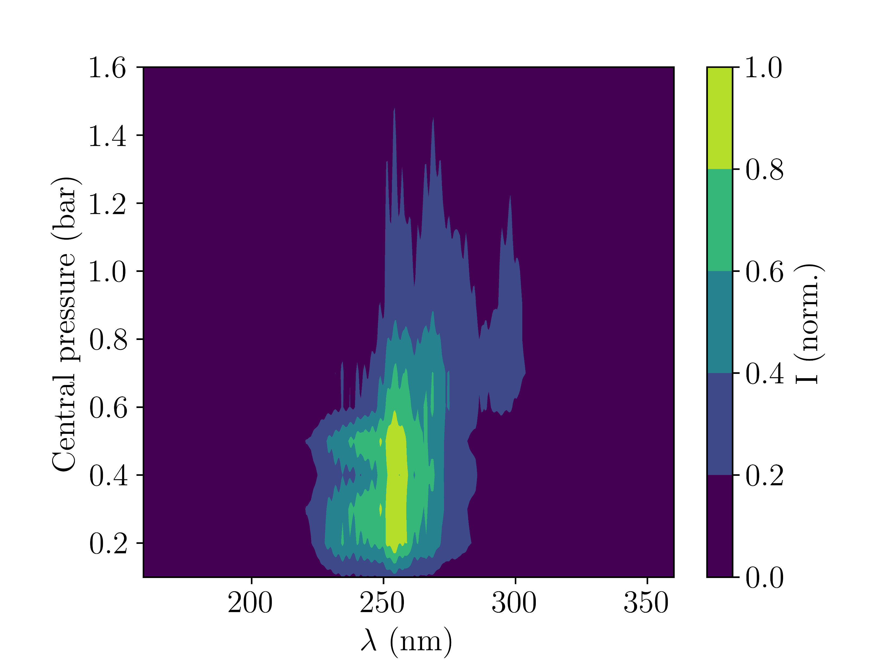
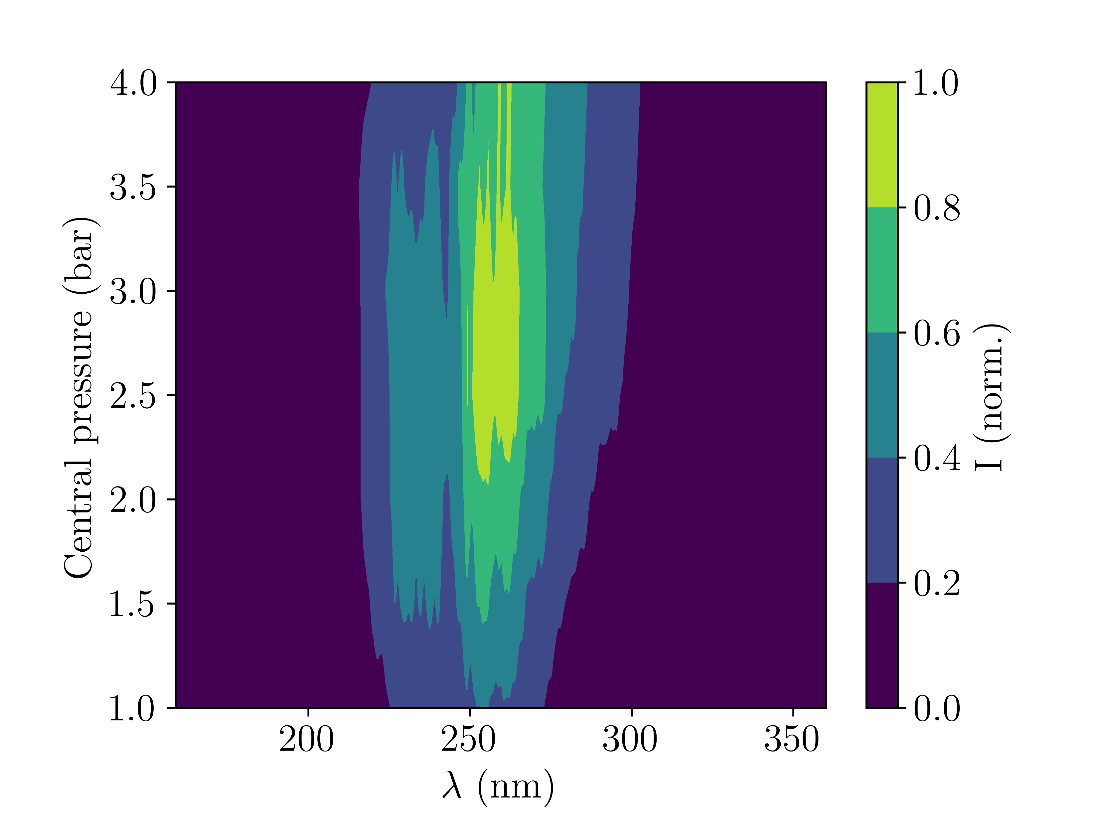
4.I Comparison with experiment
Ar (sim.)
Across different (rescaled) pressures, general spectral trends can be reproduced:
Ne (sim.)
Ar (meas.)
Fig. 8: UV output spectra at different (rescaled) central pressures. Left column: Argon (150mW), right column: Neon (400mW). Upper row: simulations, bottom row: measurements
Ne (meas.)

Slide 8
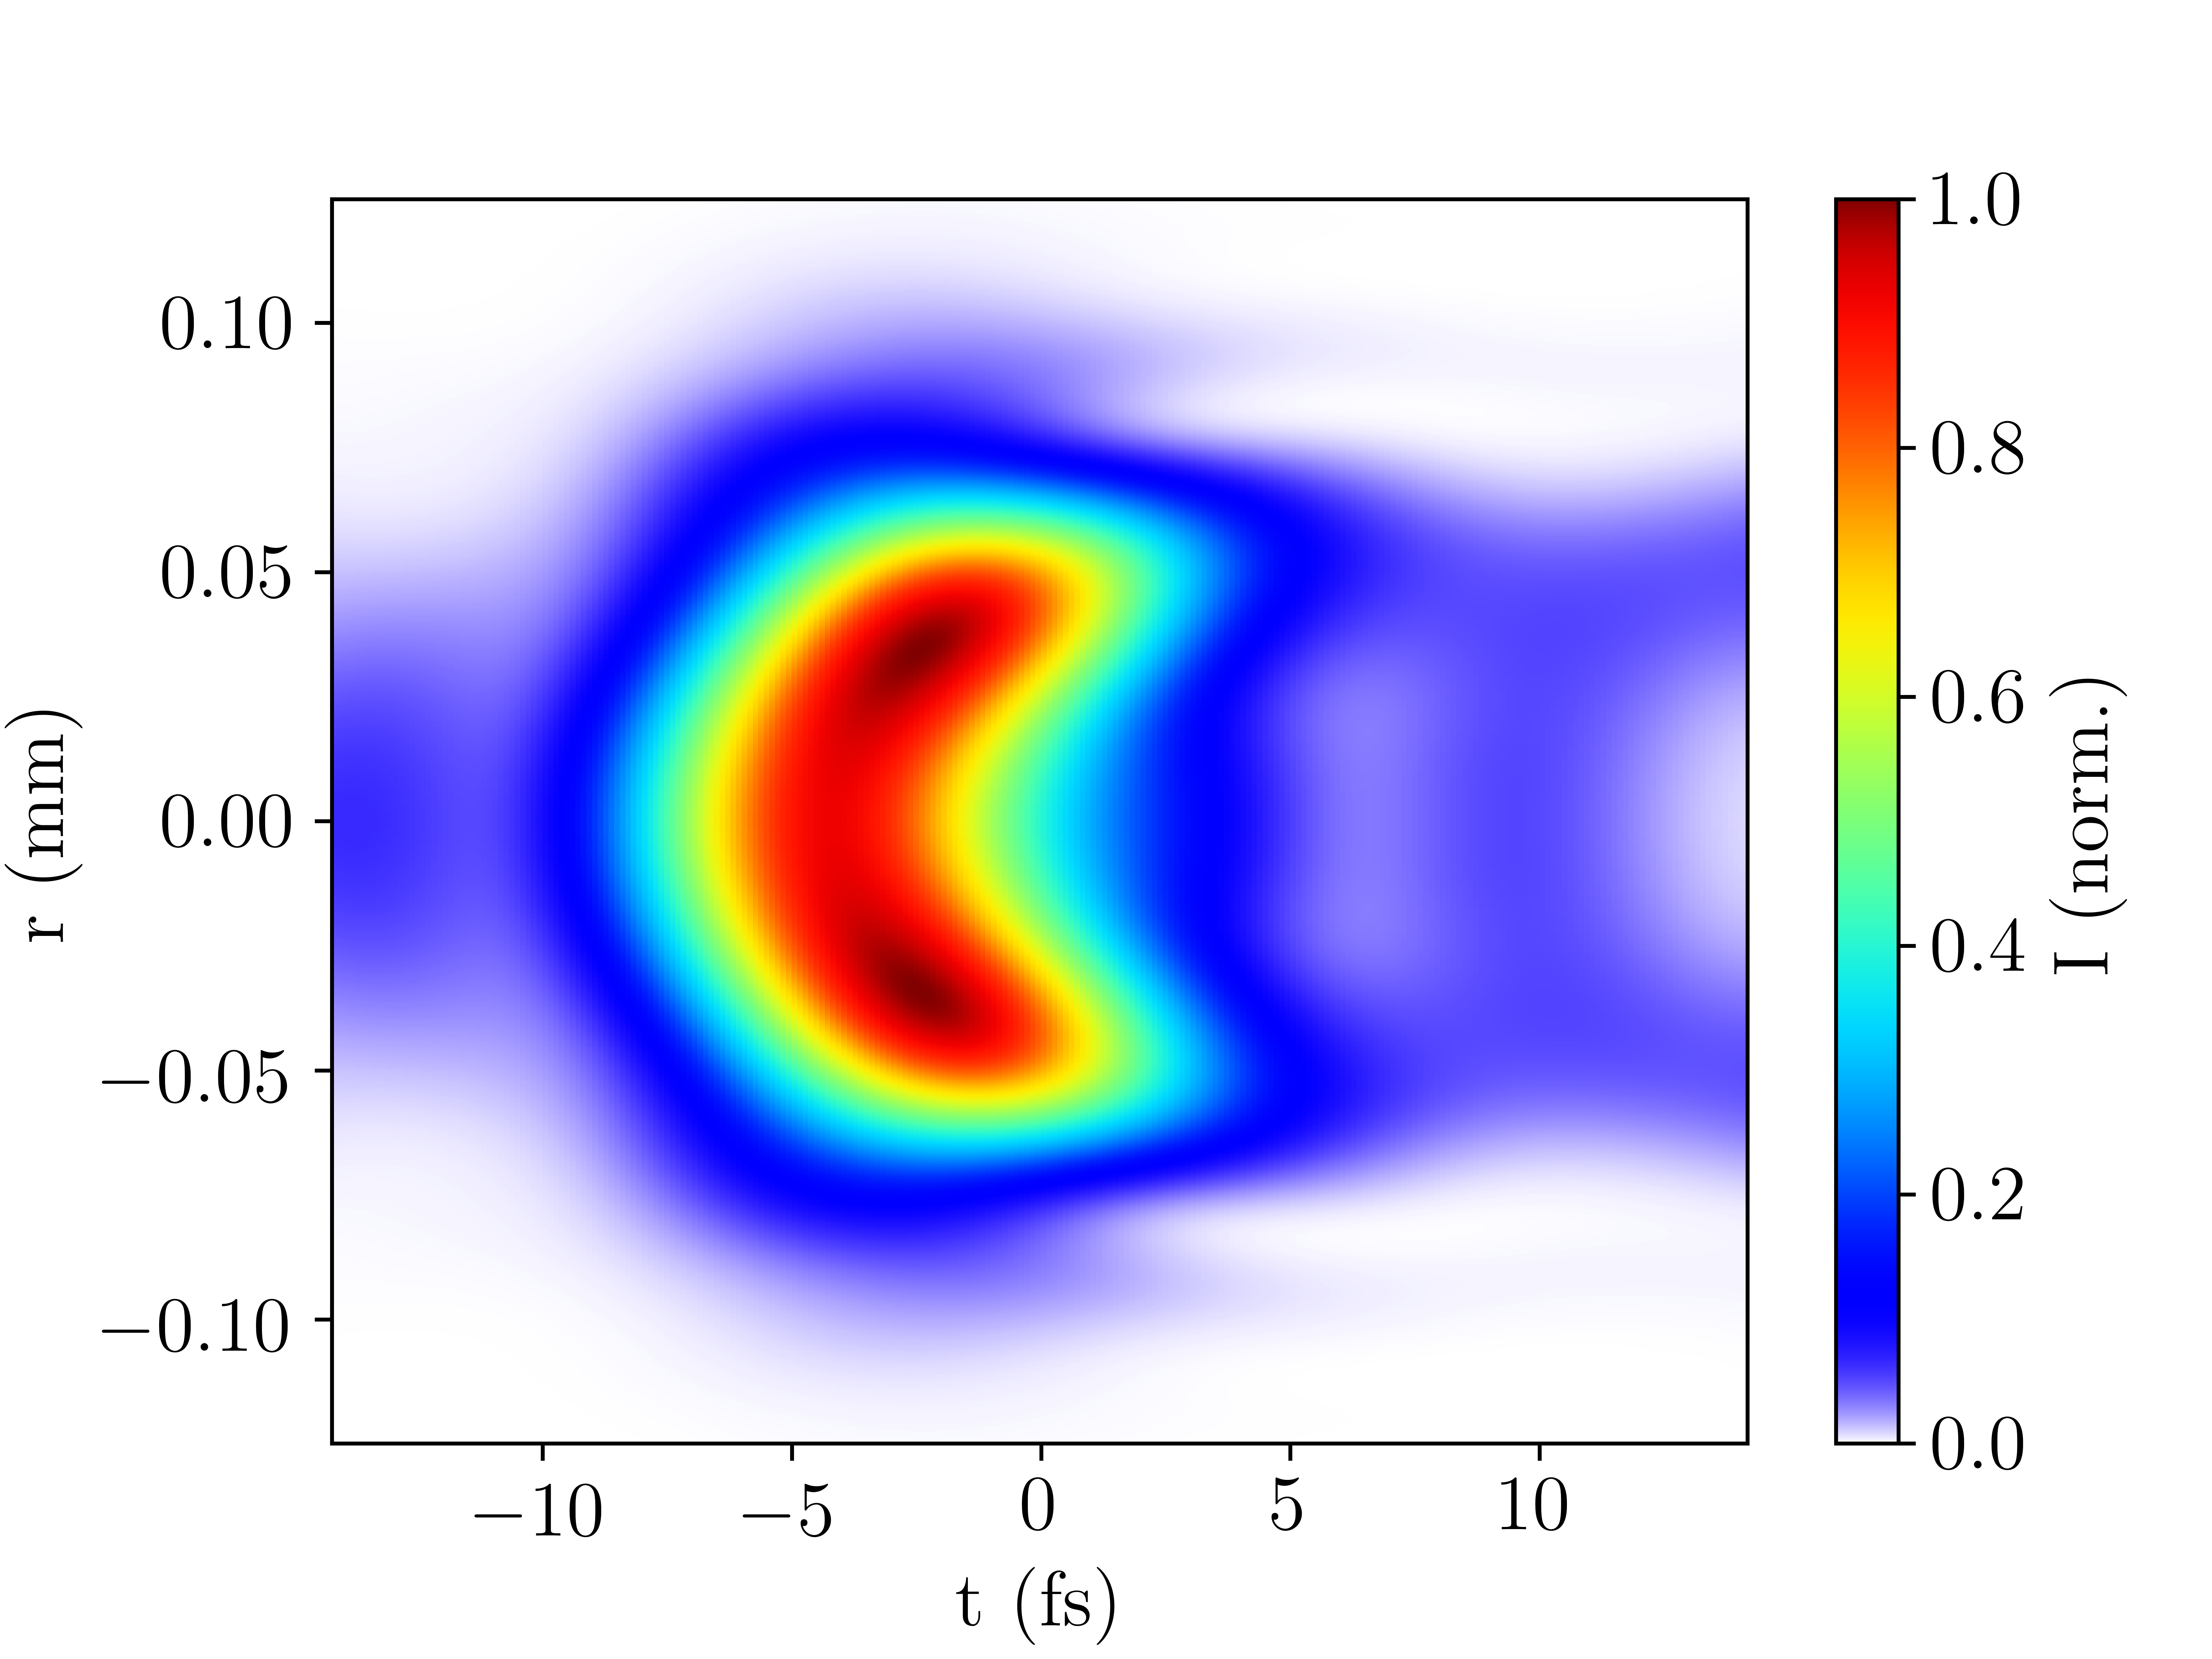
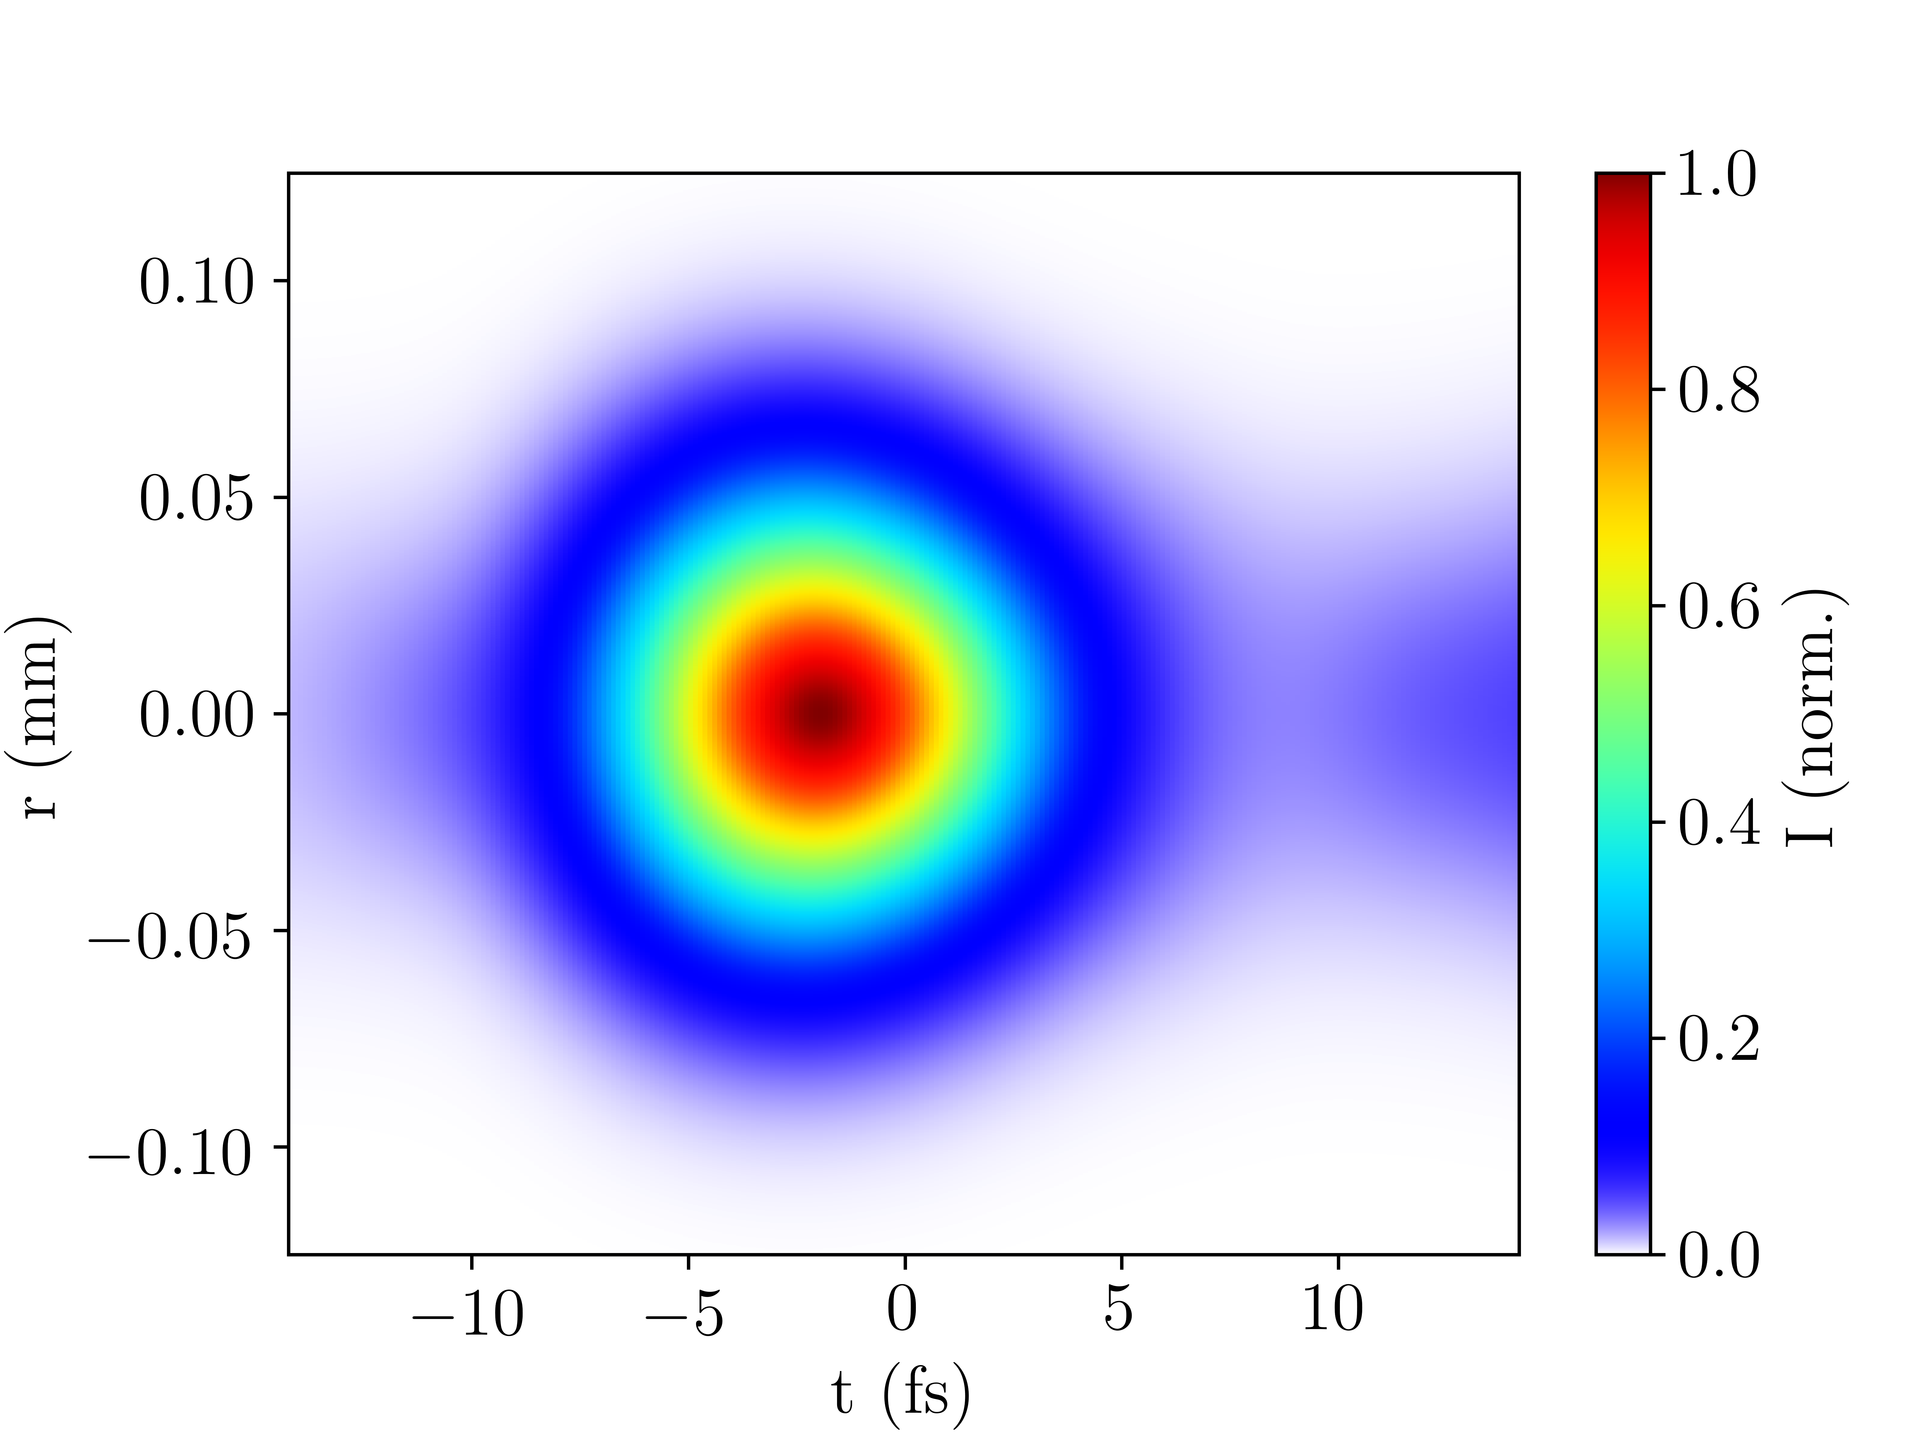
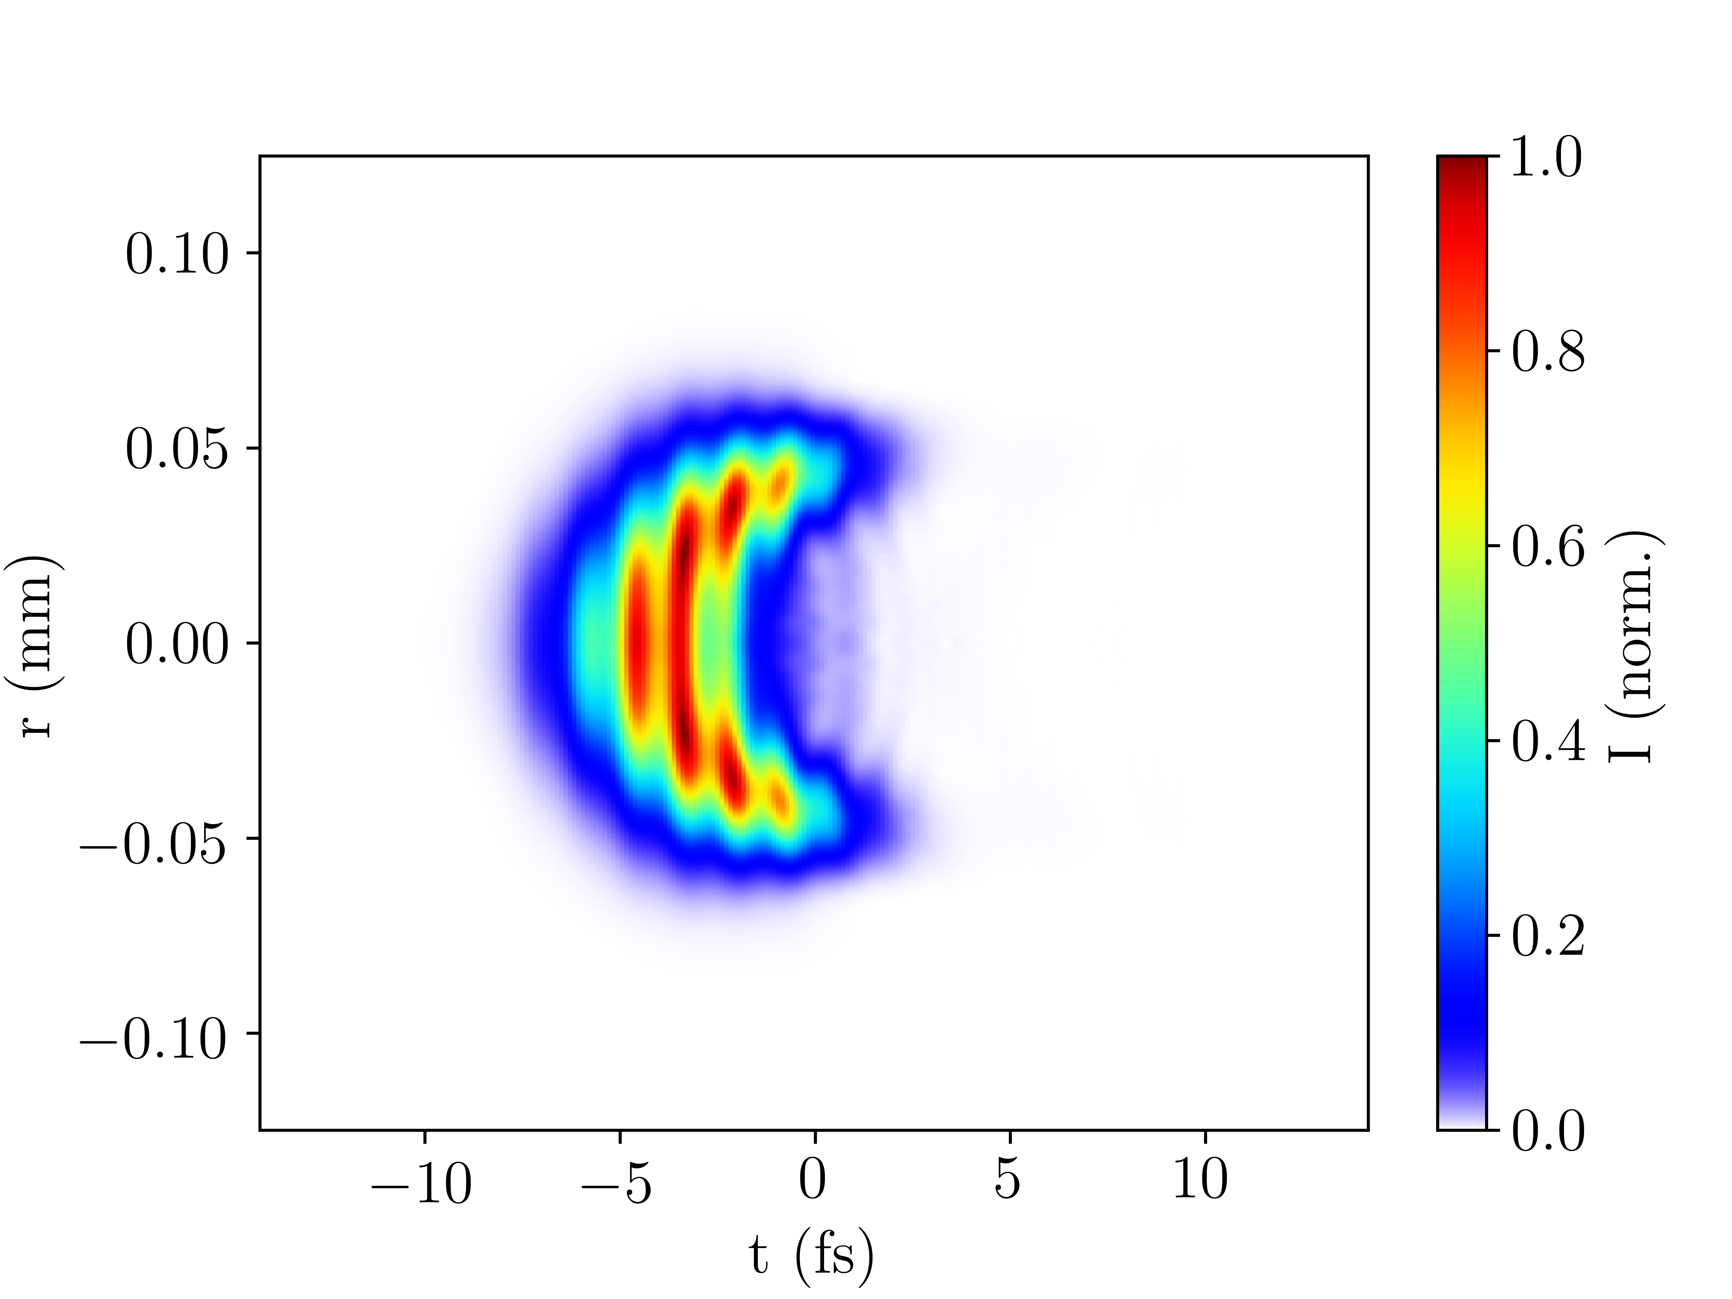
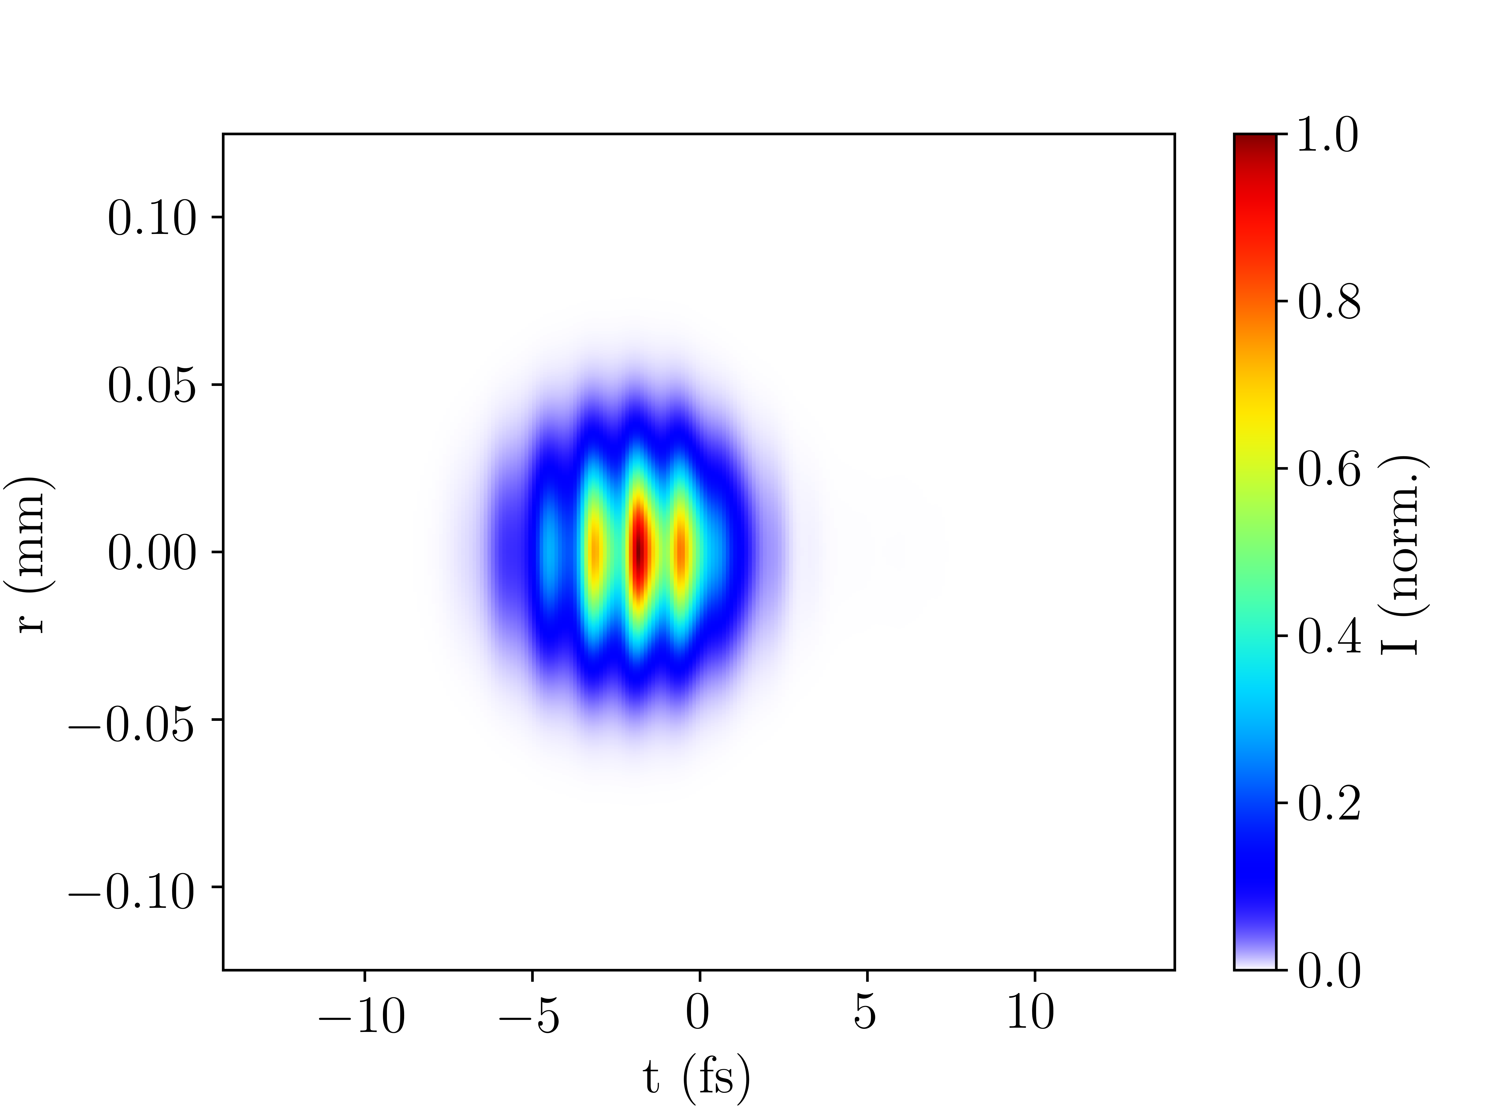
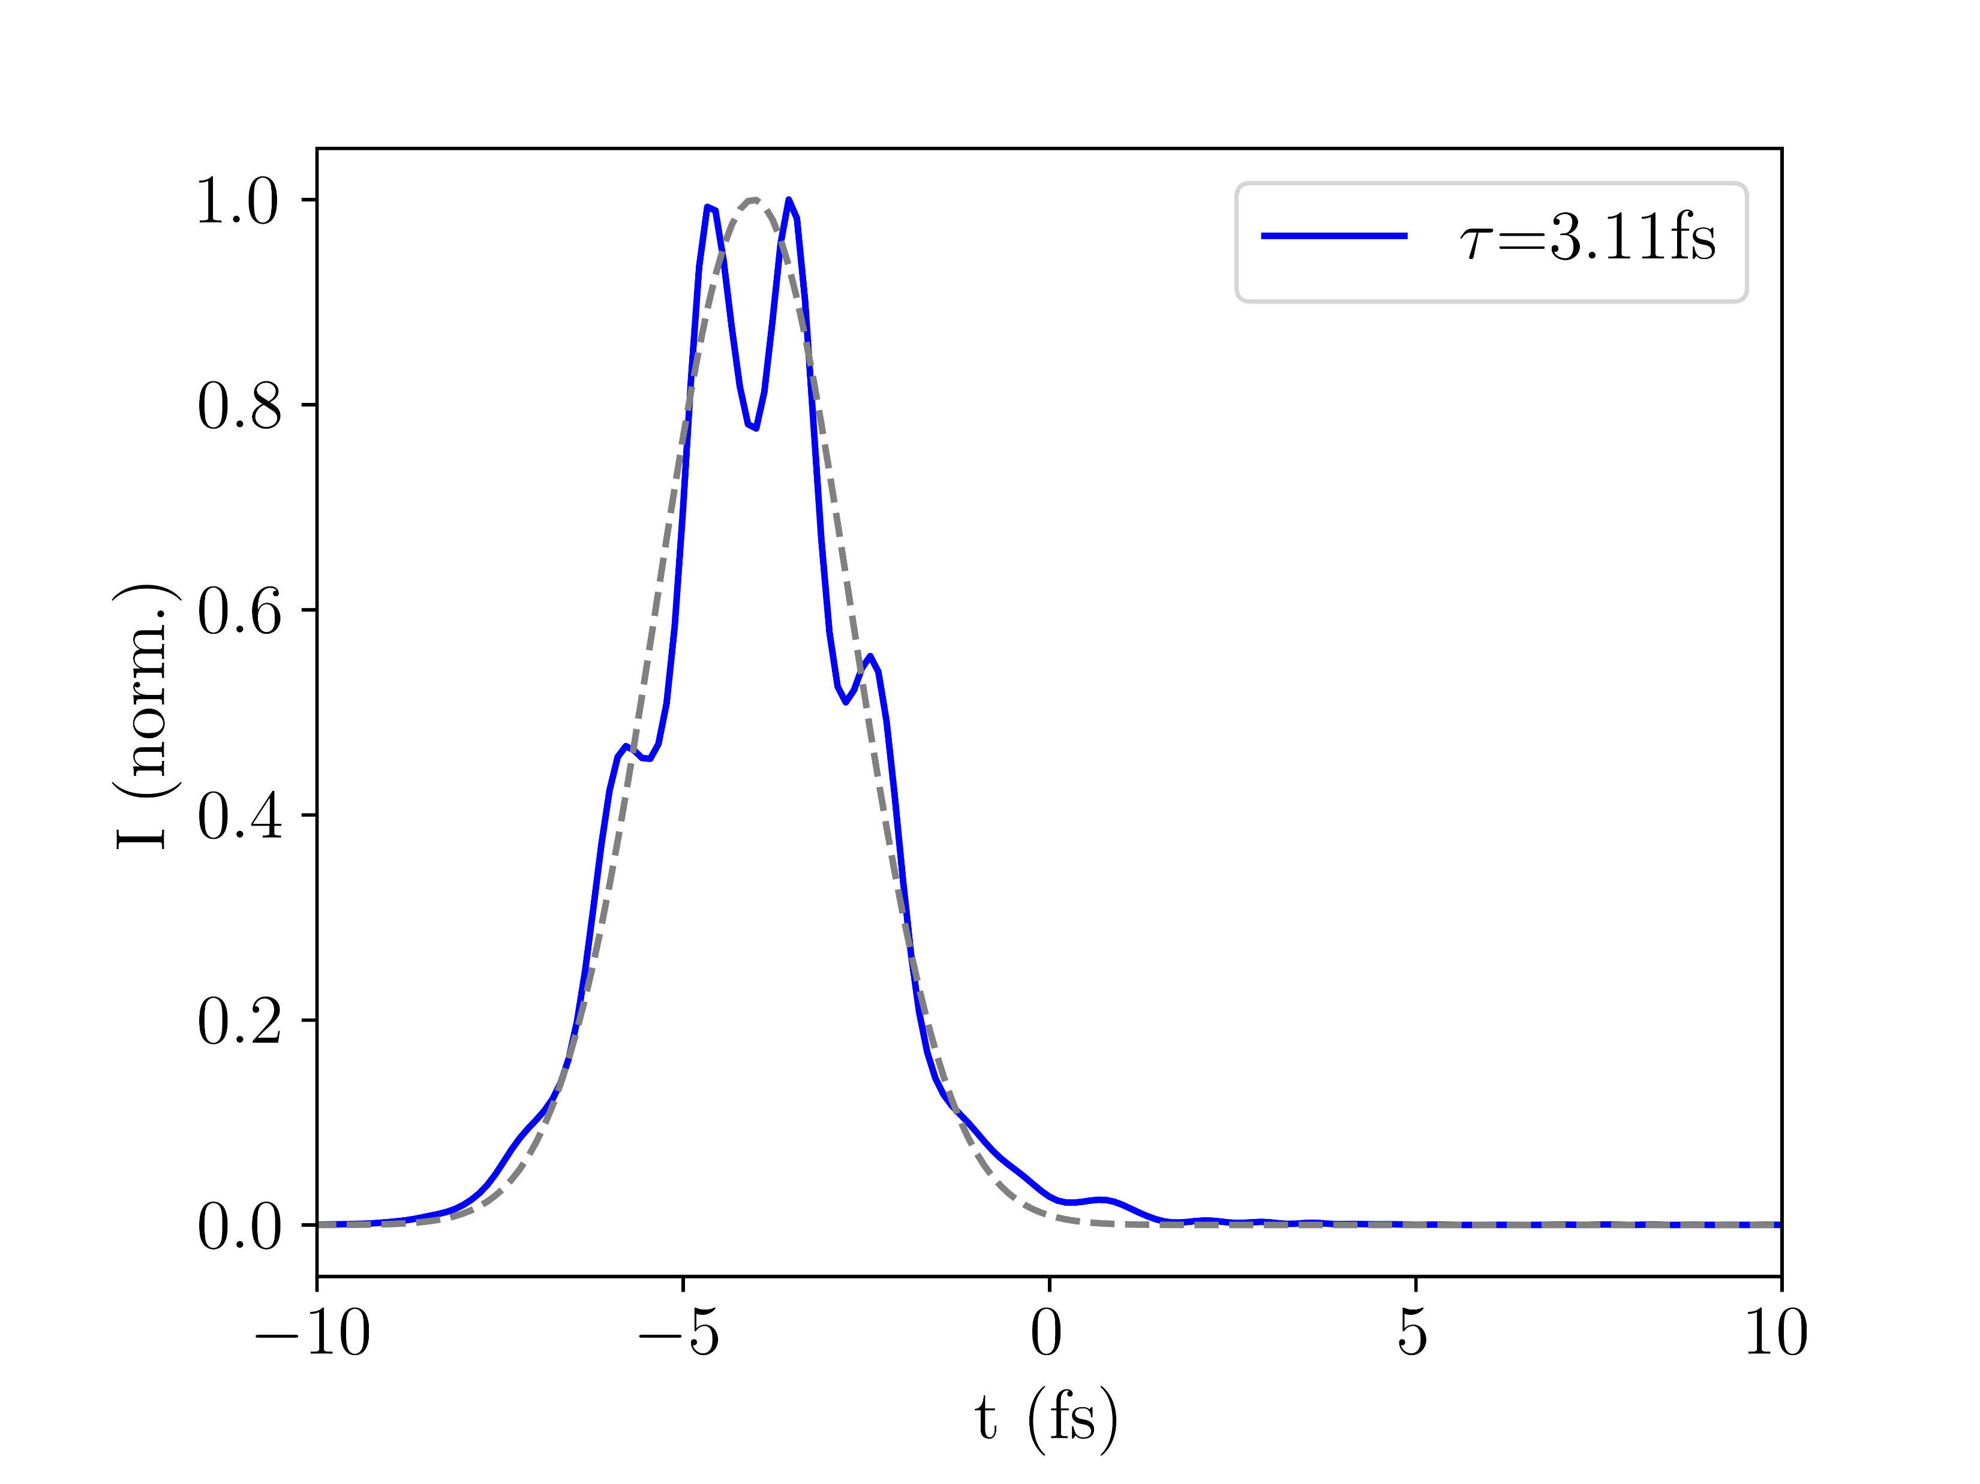
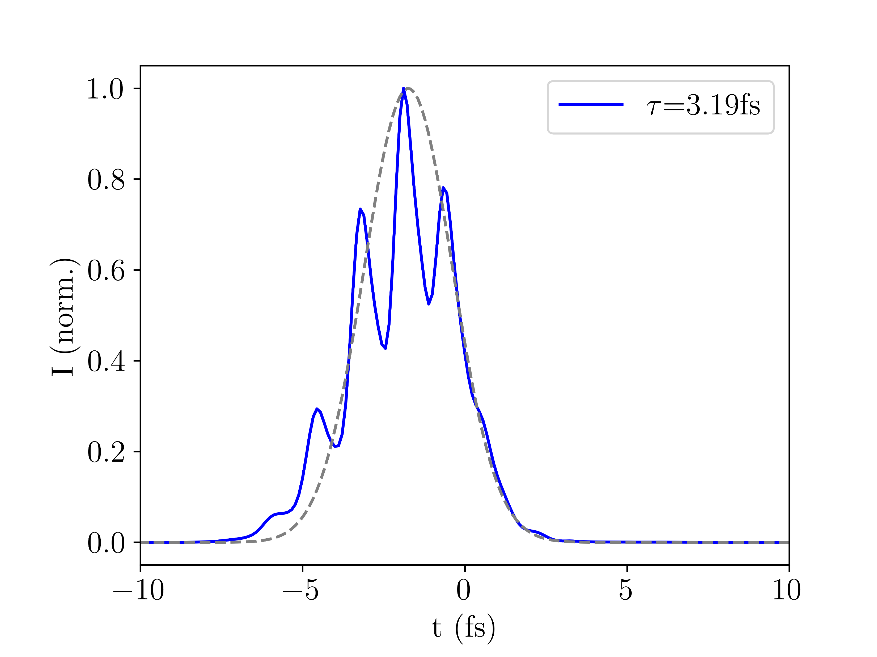
4.II Self-defocusing
The simulations show that ionisation-induced self-defocusing at the trailing edge of the UV pulse contributes to pulse compression, in qualitative agreement with literature [3]:
IR ion.
IR no ion.
UV ion.
UV no ion.
Fig. 9: IR (top row) and UV (middle and rows) output beams with (left column) and without (right column) ionisation using Argon at 150mW NIR power and 0.4bar rescaled central pressure
UV no ion.
UV ion.

Slide 9
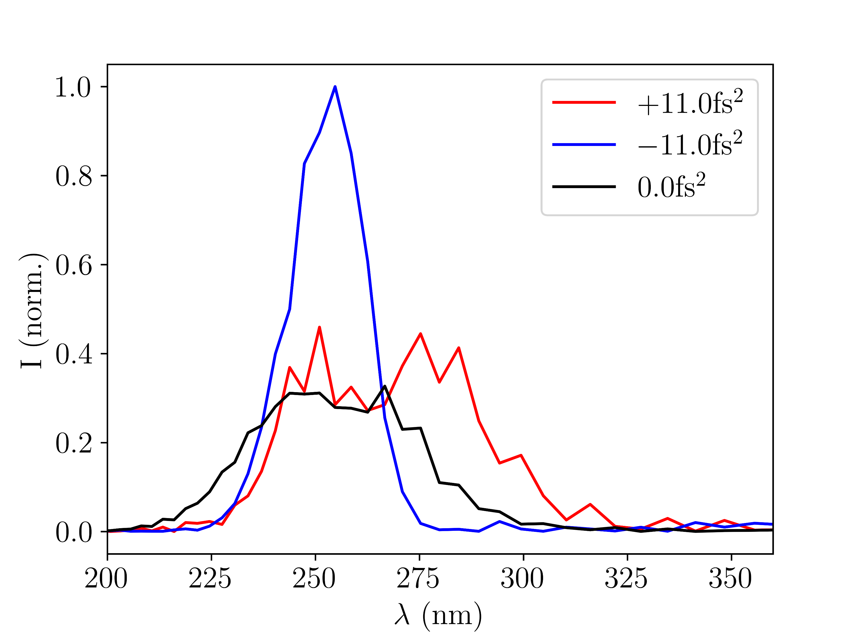
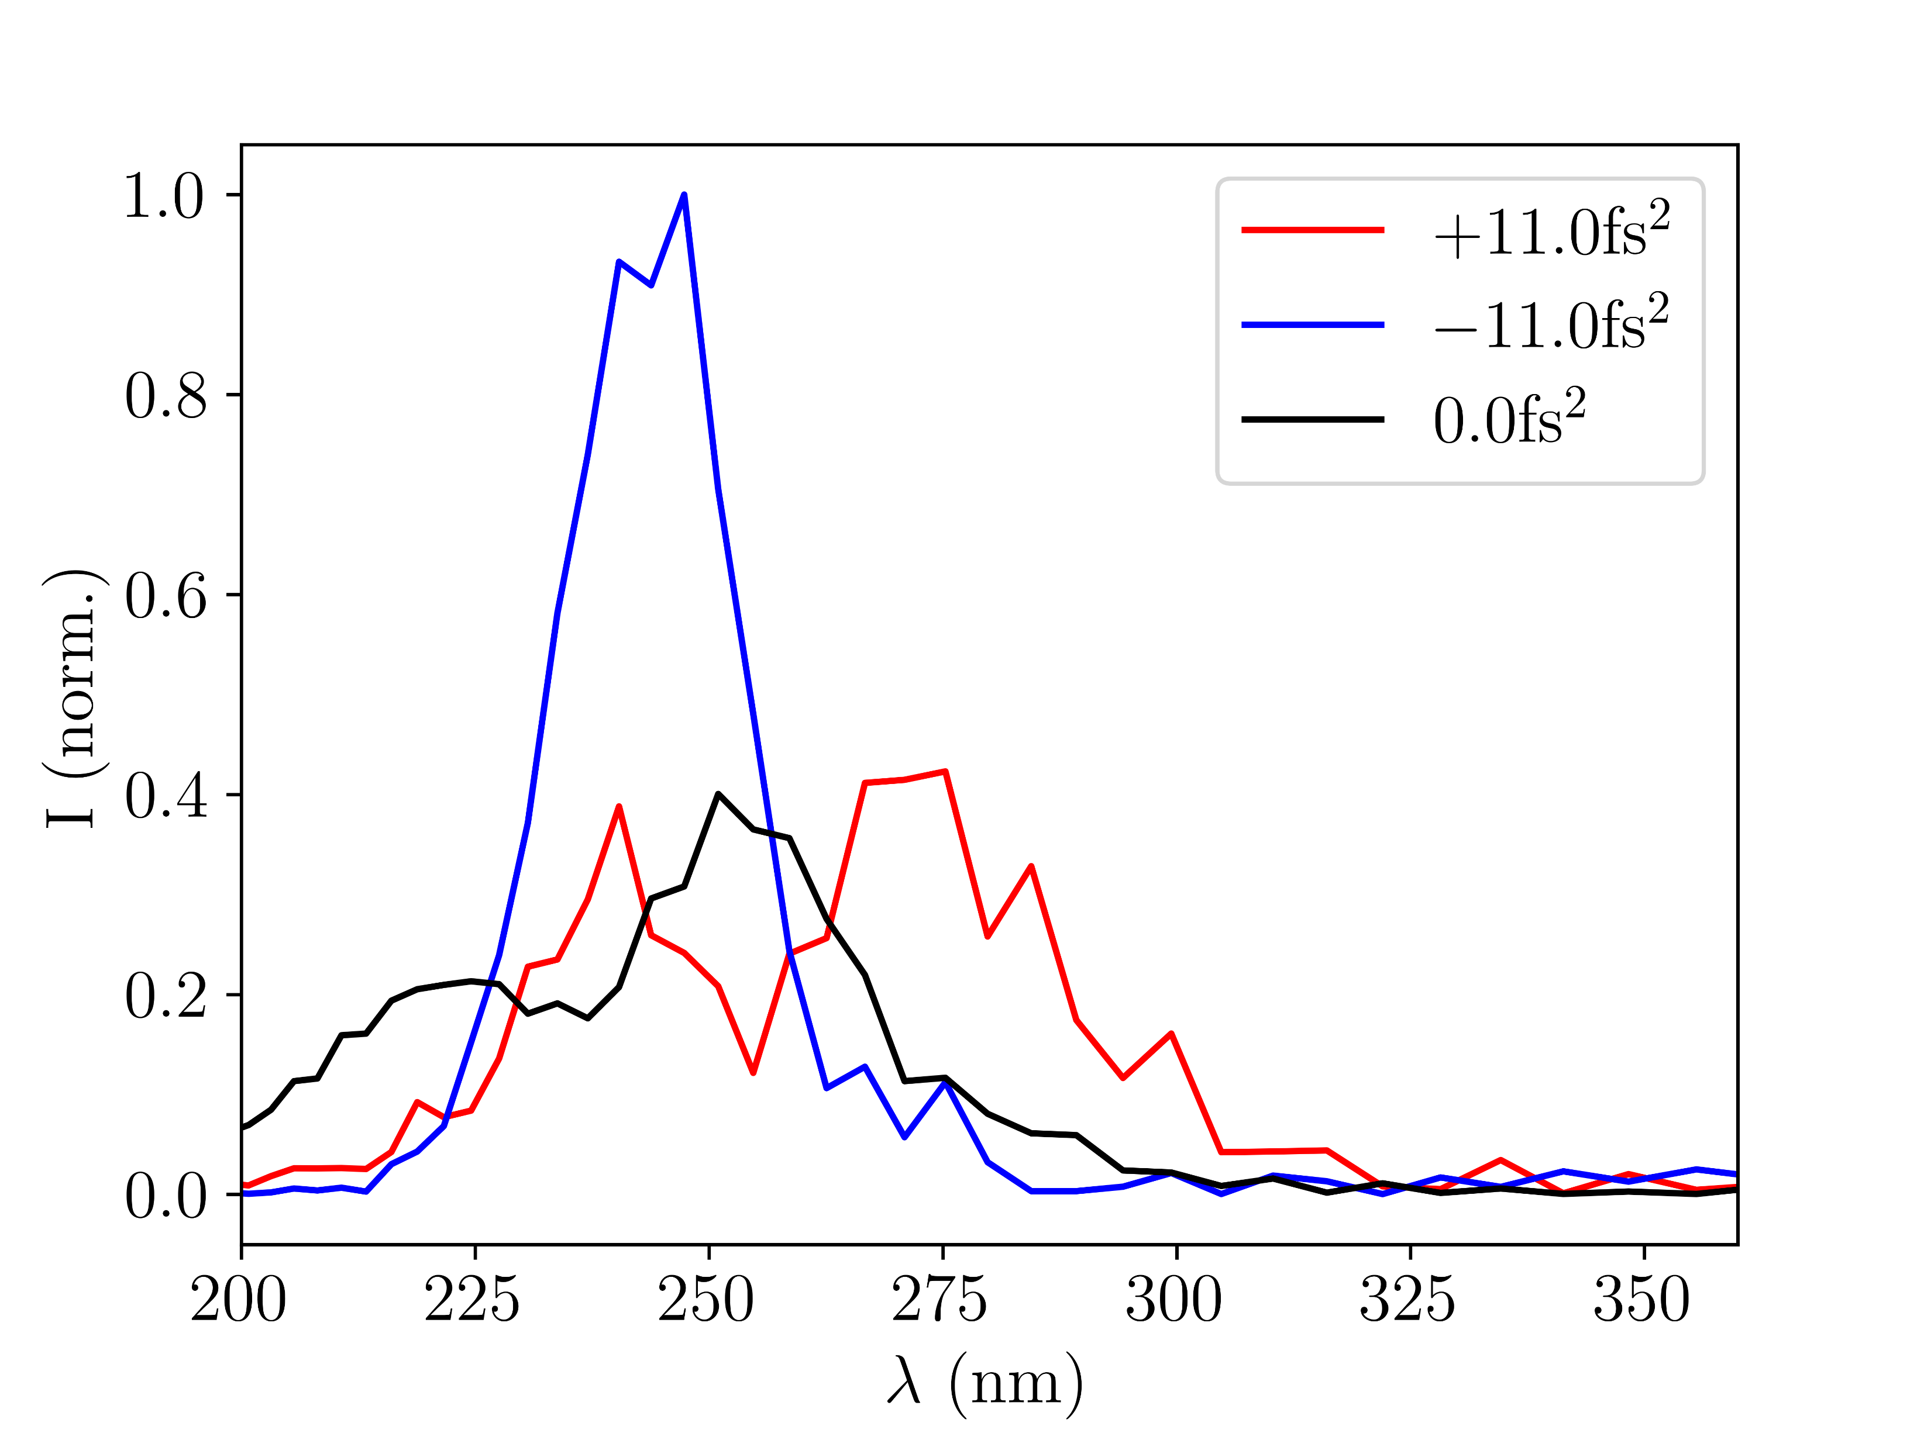
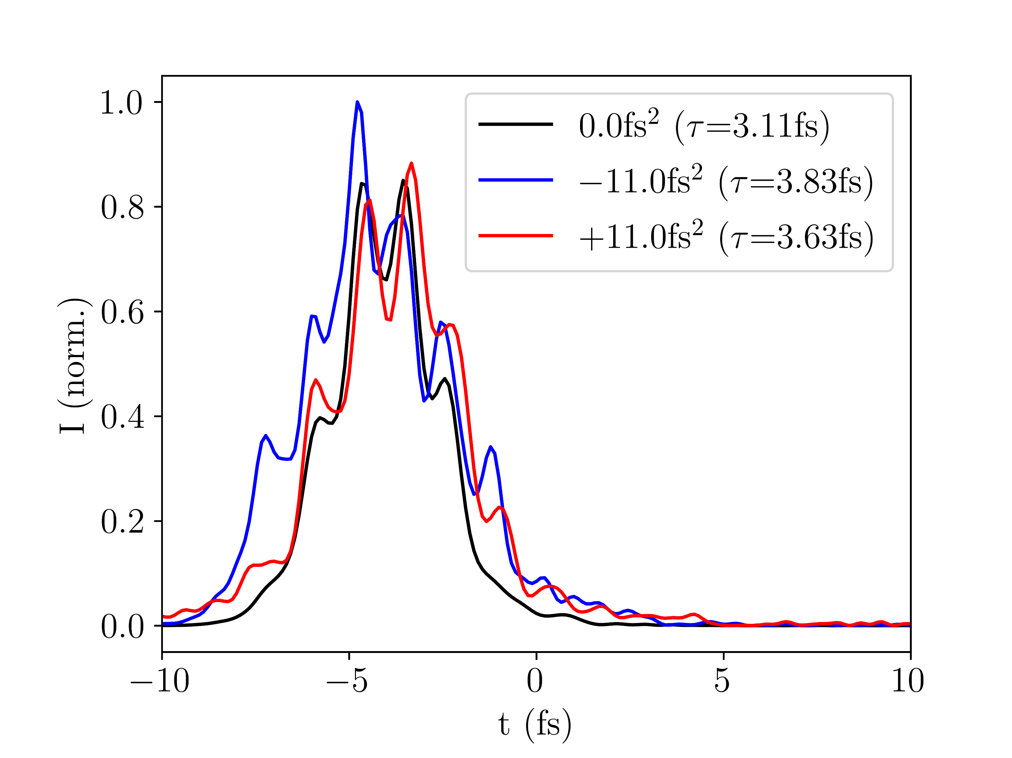
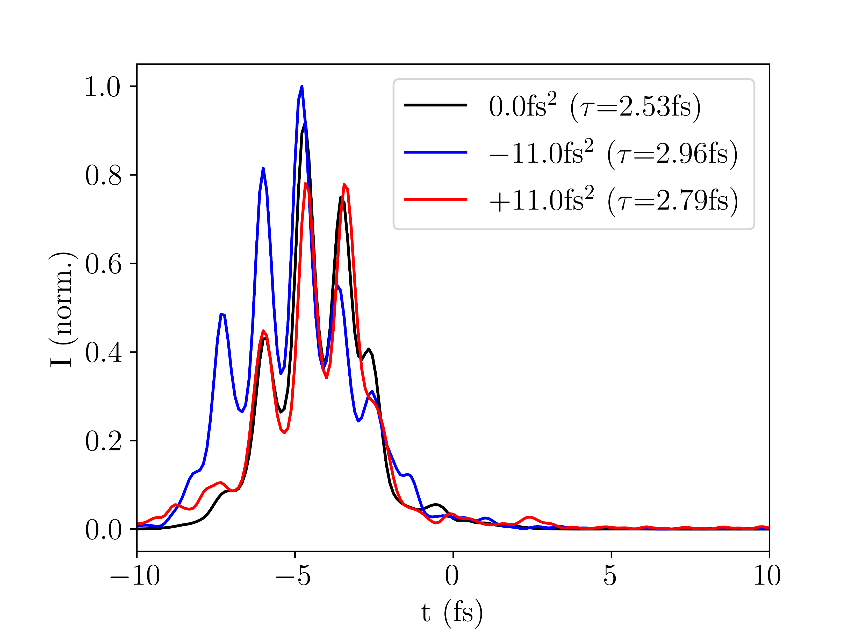
4.III Effects of chirp
The simulations indicate that using chirped input pulses could potentially improve UV pulse properties:
Ar
Ne
Fig. 10: UV output spectra and temporal profiles for different GVD values of the input pulse. Left column: Argon (150mW, 0.4bar), right column: Neon (400mW, 2.0bar); pressures rescaled
Ar
Ne

Slide 10
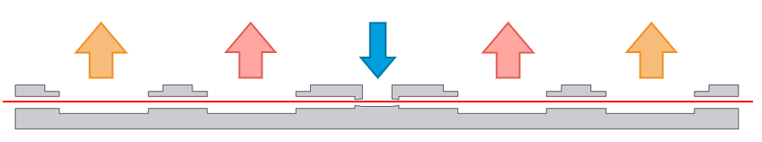
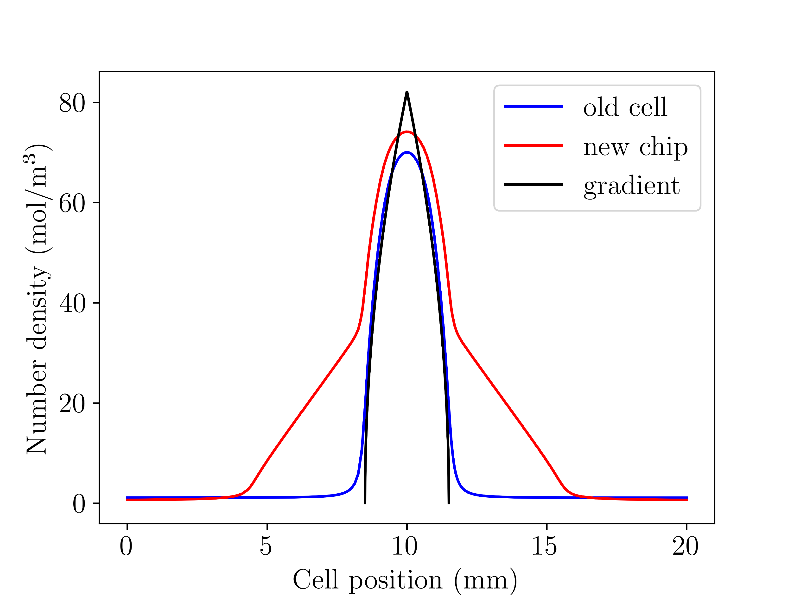
4.IV Comparing the gas cells
COMSOL simulations for the gas density distribution of the new and old cell were produced (by Josina Hahne)
Currently, these models do not sufficiently consider interactions between gas molecules at high pressures
They do allow for a qualitative comparison of the new and the old cell, however
Fig. 11: side view of the new chip Reproduced from Josina Hahne’s master’s thesis defence
Fig. 12: Gas density distribution models for the old cell, the new chip and the gradient model, all at 2.0bar

Slide 11
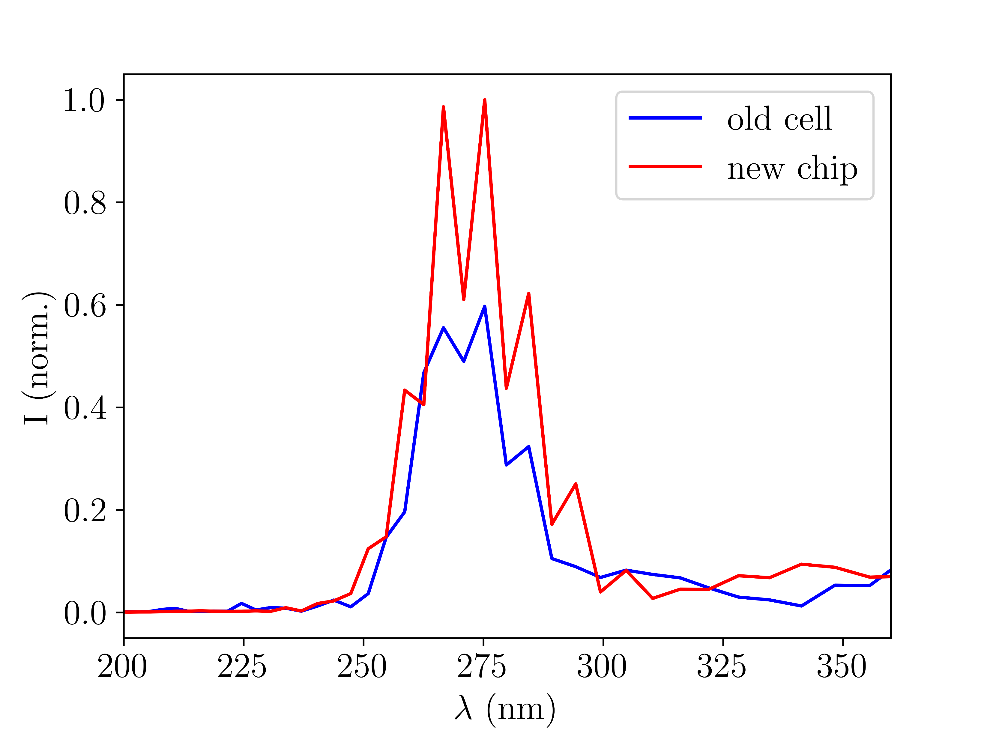
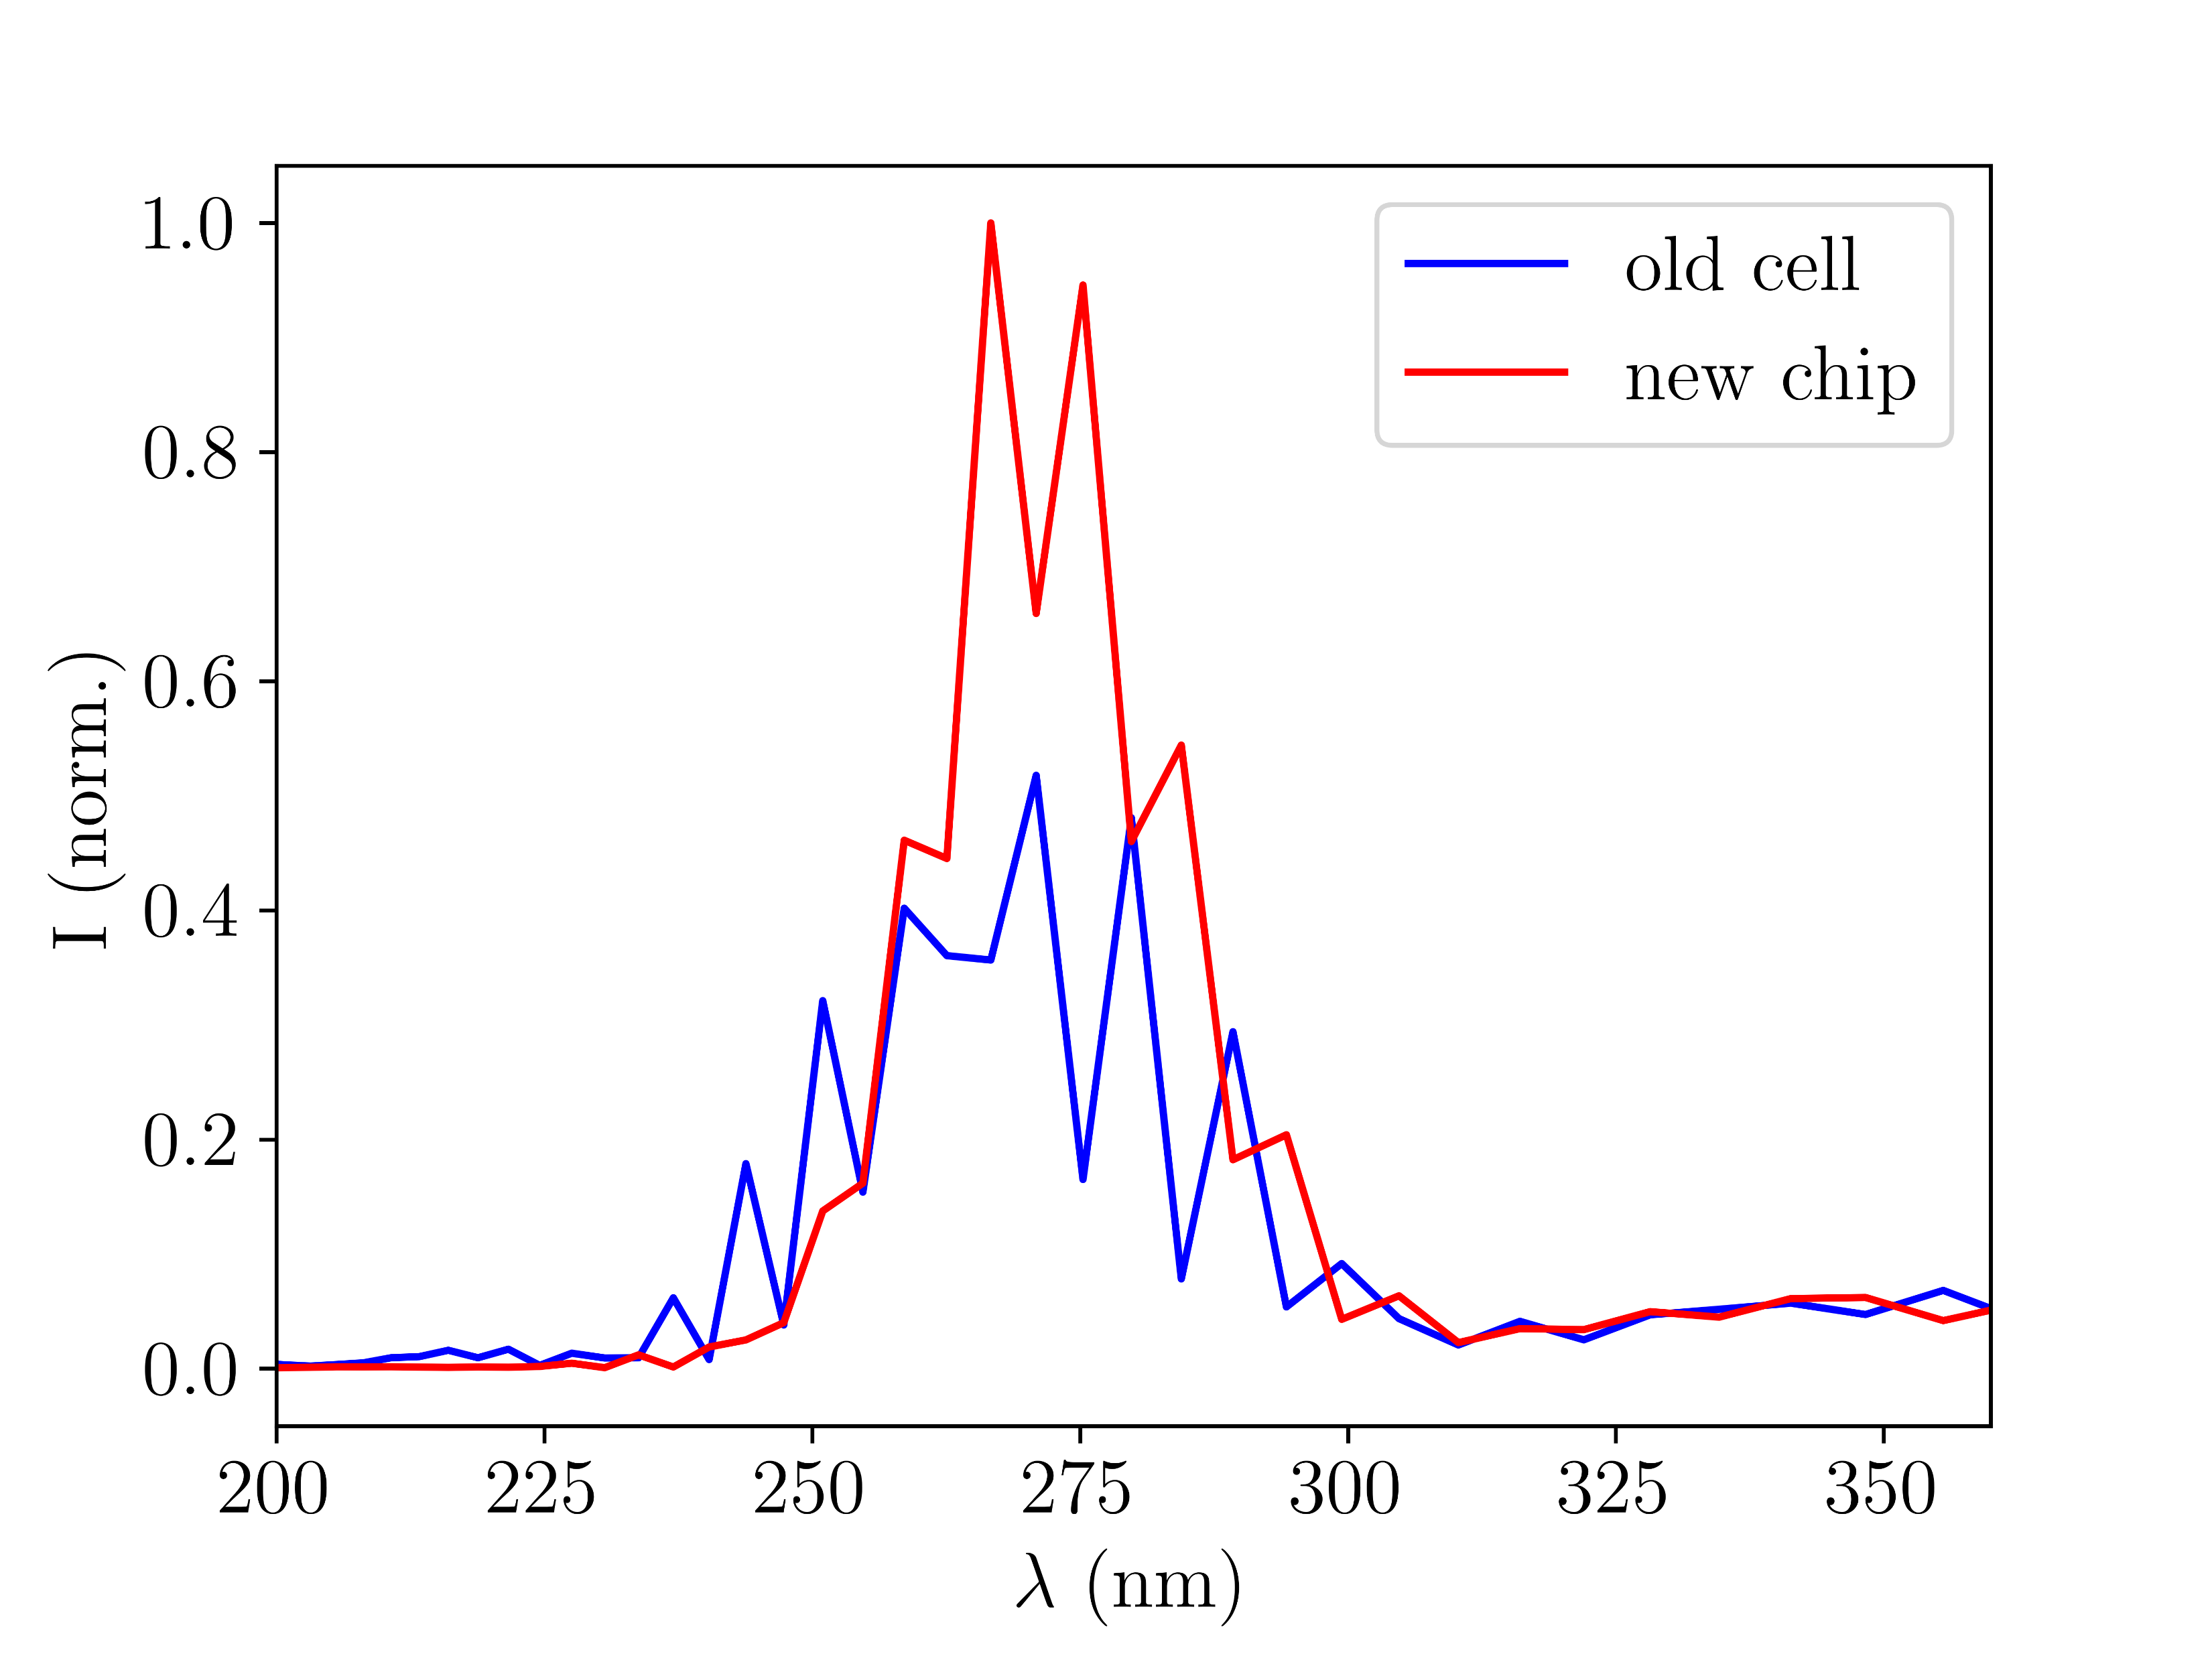
4.IV Comparing the gas cells
The simulations indicate that the new chip to delivers broader and more intense UV pulses, in agreement with experiments:
Fig. 13: UV output spectra with new and old gas cell for Argon at 150mW NIR power and 0.4bar rescaled central pressure
Fig. 14: UV output spectra with new and old gas cell for Neon at 400mW NIR power and 2.0bar rescaled central pressure

Slide 12
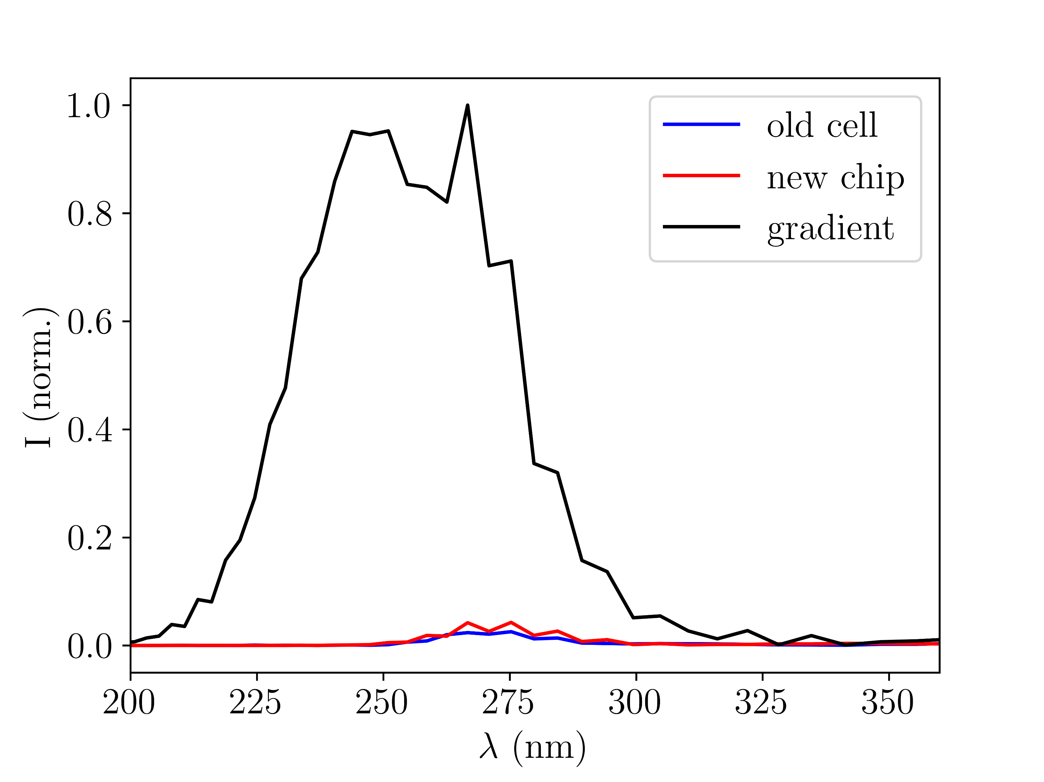
4.IV Comparing the gas cells
Interestingly, the gradient distribution results in significantly more intense UV output despite being nearly identical to the old cell in the central interaction region
This seems to indicate a large absorptive effect of the low-density regions outside the THG region
Fig. 15: UV output spectra with new and old gas cell and the gradient model for Argon at 150mW NIR power and 0.4bar rescaled central pressure

Slide 13
5. Discussion & conclusion
The THG simulations at their current stage resulted in some promising outputs, showing qualitative agreement with both experiment and literature
Some of the results shown will form part of a submission to JPhys Photonics
There is significant room for further improvements:
Base the spatial profile of the input beam on measured data
Use COMSOL simulations to accurately model the gas distribution inside and outside the central interaction region
With additional expansions, especially with regards to gas density modelling, the simulation code could in the future serve as the basis of a theoretical framework to complement experiments

Slide 14
6. Acknowledgments & references
Acknowledgments
Thank you to Josina Hahne and Vincent Wanie for all their help with the project as well as to the rest of the CFEL-ATTO team for being so welcoming and friendly.
References
[1] C. Brahms and J. C. Travers, “Luna.jl,” (2023); https://doi.org/10.5281/zenodo.8242646
[2] M. Kolesik and J. V. Moloney, “Nonlinear optical pulse propagation simulation: From Maxwell’s to unidirectional equations,” Phys. Rev. E 70, 036 604 (2004)
[3] F. Reiter, U. Graf, et al. “Route to Attosecond Nonlinear Spectroscopy,” Phys. Rev. Lett. 105, 243 902 (2010)

